Slide 1
LIM application
Take Gulf of Mexico for example

Slide 2
f15
EXP_S
mega
f26
POC_W
f10
f2
f9
f20
f24
f1
f6
f17
sed
meio
f5
f22
f3
f4
f16
f7
DIC_W
f13
f8
f18
bac
macro
f23
Exp_B
f14
f19
f21
f12
fish
f25
f27
f11

Slide 3
FLOW | SYM | MEANING
f1 | POC_W->SED | POC particle rain to sediment
f2 | SED->EXP_S | Sediment export(e.g. downslope, burial…)
f3 | SED->BAC | bacteria feed on sediment
f4 | BAC->SED | bacteria feces deposit on sediment
f5 | SED->MEI | Meiofauna feed on sediment
f6 | MEI->SED | meiofauna feces deposit on sediment
f7 | SED->MAC | Macrofauna feed on sediment
f8 | MAC->SED | macrofauna feces deposit on sediment
f9 | SED->MEG | megafauna feed on sediment
f10 | MEG->SED | megafauna feces deposit on sediment
f11 | SED->FIS | Fish feeds on sediment (carcass)
f12 | FIS->SED | Fish feces deposit on sediment
f13 | BAC->MEI | Meiofauna feed on bacteria
f14 | BAC->MAC | Macrofauna feed on bacteria
f15 | BAC->MEG | Megafauna feed on bacteria
f16 | MEI->MAC | Macrofauna feed on meiofauna
f17 | MEI->MEG | Megafauna feed on meiofauna
f15
EXP_S
mega
f26
POC_W
f10
f2
f9
f20
f24
f1
sed
f6
meio
f17
f5
f22
f3
f4
f16
f7
DIC_W
bac
f13
f8
f18
macro
Exp_B
f14
f23
f21
f19
f12
fish
f25
f27
f11

Slide 4
FLOW | SYM | MEANING
f18 | MAC->MEG | Megafauna feed on macrofauna
f19 | MAC->FIS | Fish feed on macrofauna
f20 | MEG->FIS | Fish feed on megafauna
f21 | BAC->DIC_W | Bacteria respiration
f22 | MEI->DIC_W | Meiofauna respiration
f23 | MAC->DIC_W | macrofauna respiration
f24 | MEG->DIC_W | megafauna respiration
f25 | FIS->DIC_W | fish respiration
f26 | MEG->EXP_B | Megafauna loss to predation
f27 | FIS->EXP_B | fish loss to predation
f15
EXP_S
mega
f26
POC_W
f10
f2
f9
f20
f24
f1
sed
f6
meio
f17
f5
f22
f3
f4
f16
f7
DIC_W
bac
f13
f8
f18
macro
Exp_B
f14
f23
f21
f19
f12
fish
f25
f11
f27

Slide 5
Stock
Compart-ment | Stock (mgC/m2) MT1 (482 m) | Stock (mgC/m2) MT3 (985m) | Stock (mgC/m2) S36 (768m) | Stock (mgC/m2) S42 (1838m)
SED | 7.6E+05 | 7.02E+05 | 6.72E+05 | 3.75E+05
BAC | 2585 | 2465 | 2035 | 1855
MEI | 208 | 194 | 272 | 197
MAC | 816 | 110 | 110 | 60
MEG | 30.6 | 59.5 | 9.43 | 7.9
FIS | 35.9 | 35.4 | 7.4 | 24.7
Rowe et al. (2008)

Slide 6
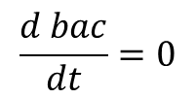
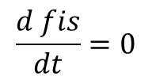
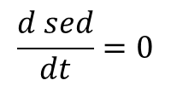
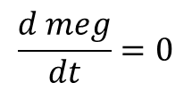
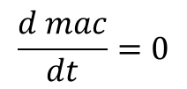
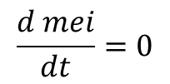
Ax=b
Mass conservation
f15
EXP_S
mega
f26
$$\frac{d sed}{dt}=0$$
POC_W
f10
f2
f9
f20
f24
$$\frac{d bac}{dt}=0$$
f1
sed
f6
meio
f17
$$\frac{d mei}{dt}=0$$
f5
f22
f3
f4
f16
$$\frac{d mac}{dt}=0$$
f7
DIC_W
bac
f13
f8
f18
macro
Exp_B
f14
f23
$$\frac{d meg}{dt}=0$$
f21
f19
f12
fish
f25
$$\frac{d fis}{dt}=0$$
f27
f11

Slide 7
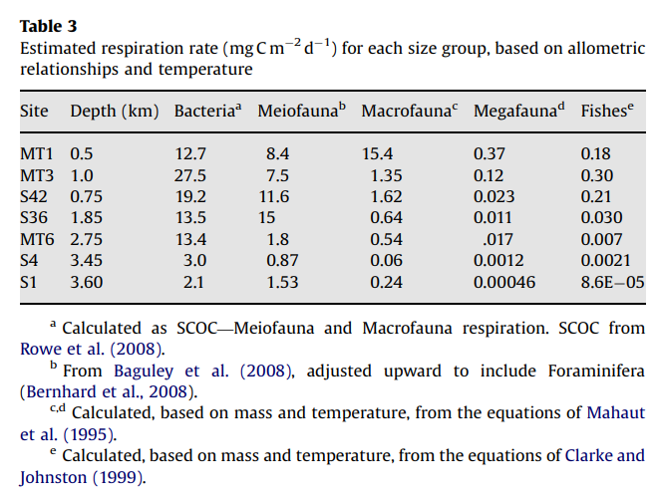
Gx>=h
Respiration
Use as upper boundary
(lower boundary=0)

Slide 8
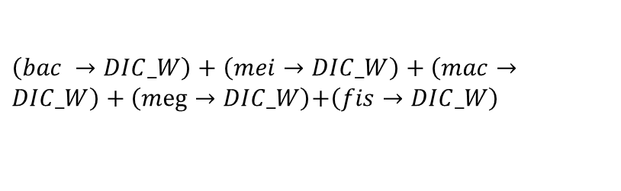
Ex=f
f15
EXP_S
mega
f26
Sediment community respiration:
POC_W
f10
$\left(bac →DIC_W\right)+\left(mei→DIC_W\right)+\left(mac→DIC_W\right)+\left(meg→DIC_W\right)$+$\left(fis→DIC_W\right)$
f2
f9
f20
f24
f1
MT1: 36.5 (mg C/m2/d)
MT3: 36.3 (mg C/m2/d)
S42: 32.4
S36: 29.1
sed
f6
meio
f17
f5
f22
(Rowe et al., 2008)
f3
f4
f16
f7
DIC_W
bac
f13
f8
f18
macro
Exp_B
f14
f23
f21
f19
f12
fish
f25
f11
f27

Slide 9
Ex=f
Compart-ment | Stock (mgC/m2) MT1 (482 m) | Stock (mgC/m2) MT3 (985m) | Stock (mgC/m2) S36 (768m) | Stock (mgC/m2) S42 (1838m)
SED | 7.6E+05 | 7.02E+05 | 6.72E+05 | 3.75E+05
OC burial rate (kg/m2/d)
S42: 56/365=56000000/365 (mgC/m2/d)
MT3: 64/365
S36: 84/365
Santschi &Rowe (2008)
POC flux (mgC/m2/d)
MT1: 77.7
S42: 13.4
MT3: 22.5
S36: 11.4
Biggs et al(2008)
POC_W
EXP_S
f1
f2
sed
sed

Slide 10
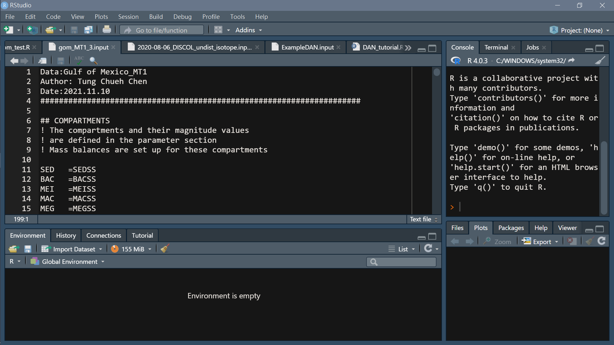
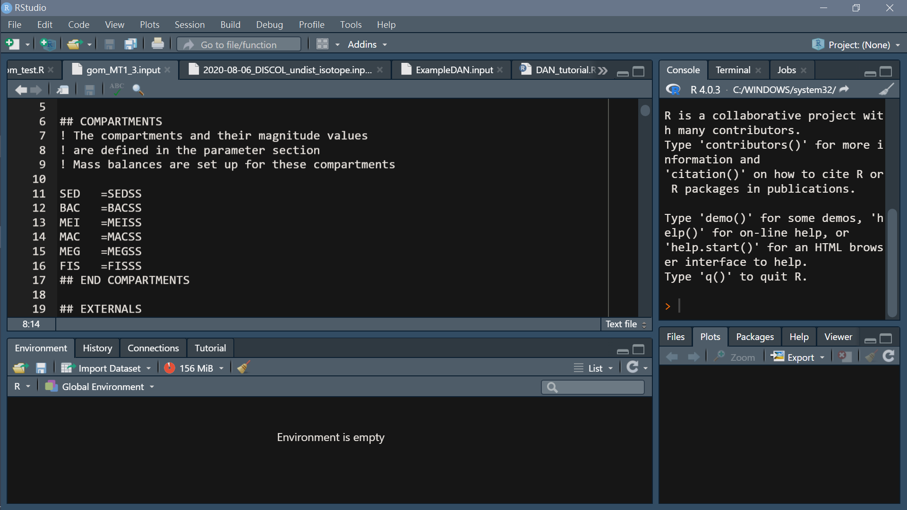
Composition of LIM input file
File name/note…
Headers (specified)
Compartment
Any line starting with ! and blank lines are ignored

Slide 11
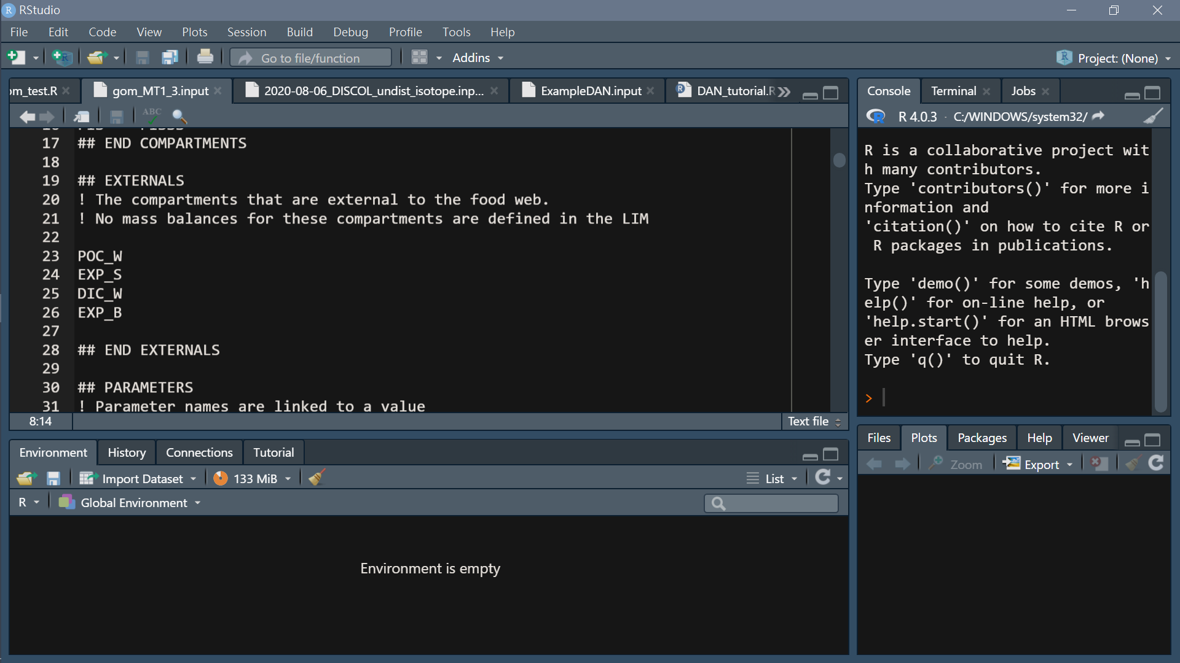
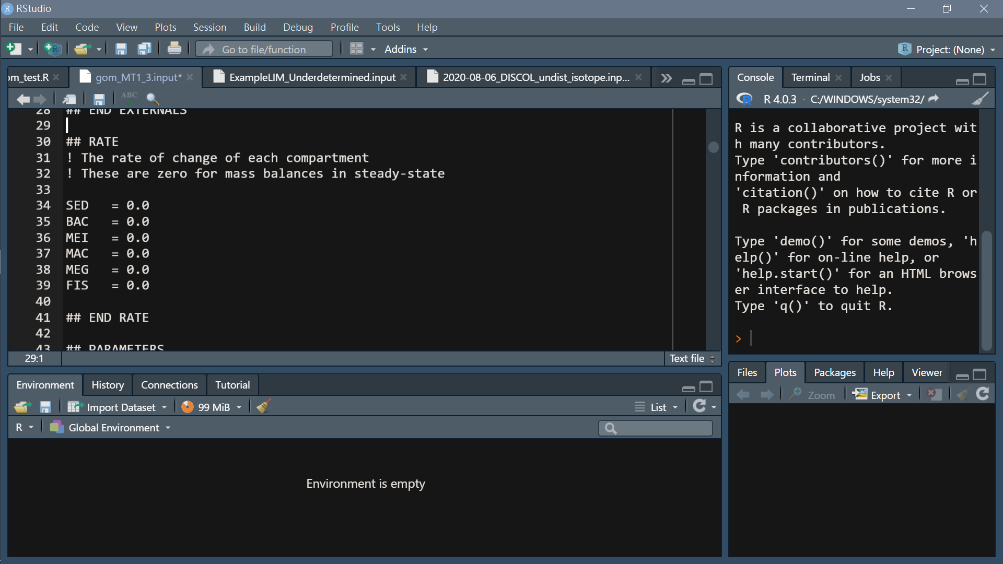
Headers (specified)
2. Externals
Headers (specified)
Rates
Default=0

Slide 12
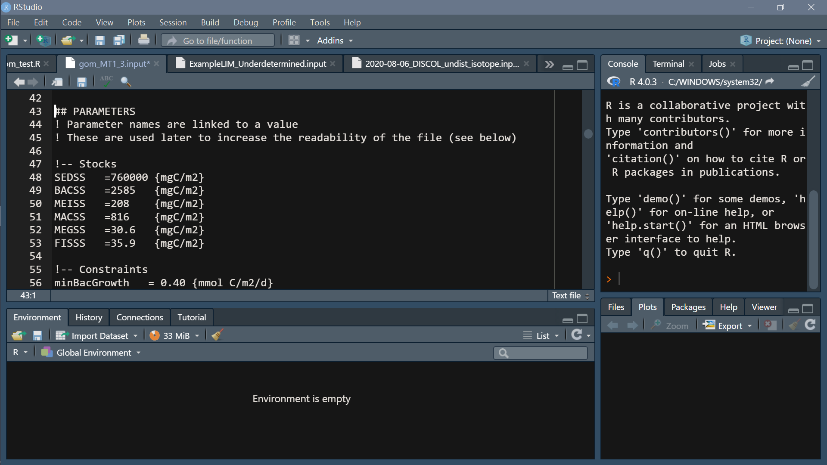
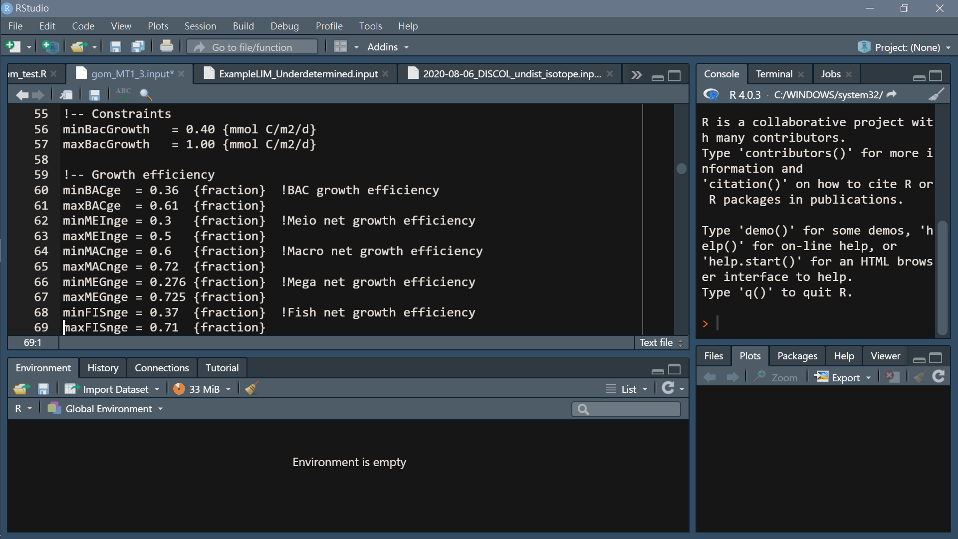
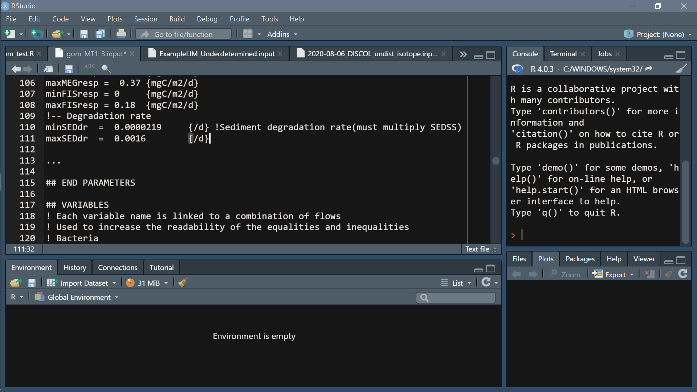
Headers (specified)
4. Parameter
Units may be included between curly brackets. e.g. {mgC/m2/d}

Slide 13
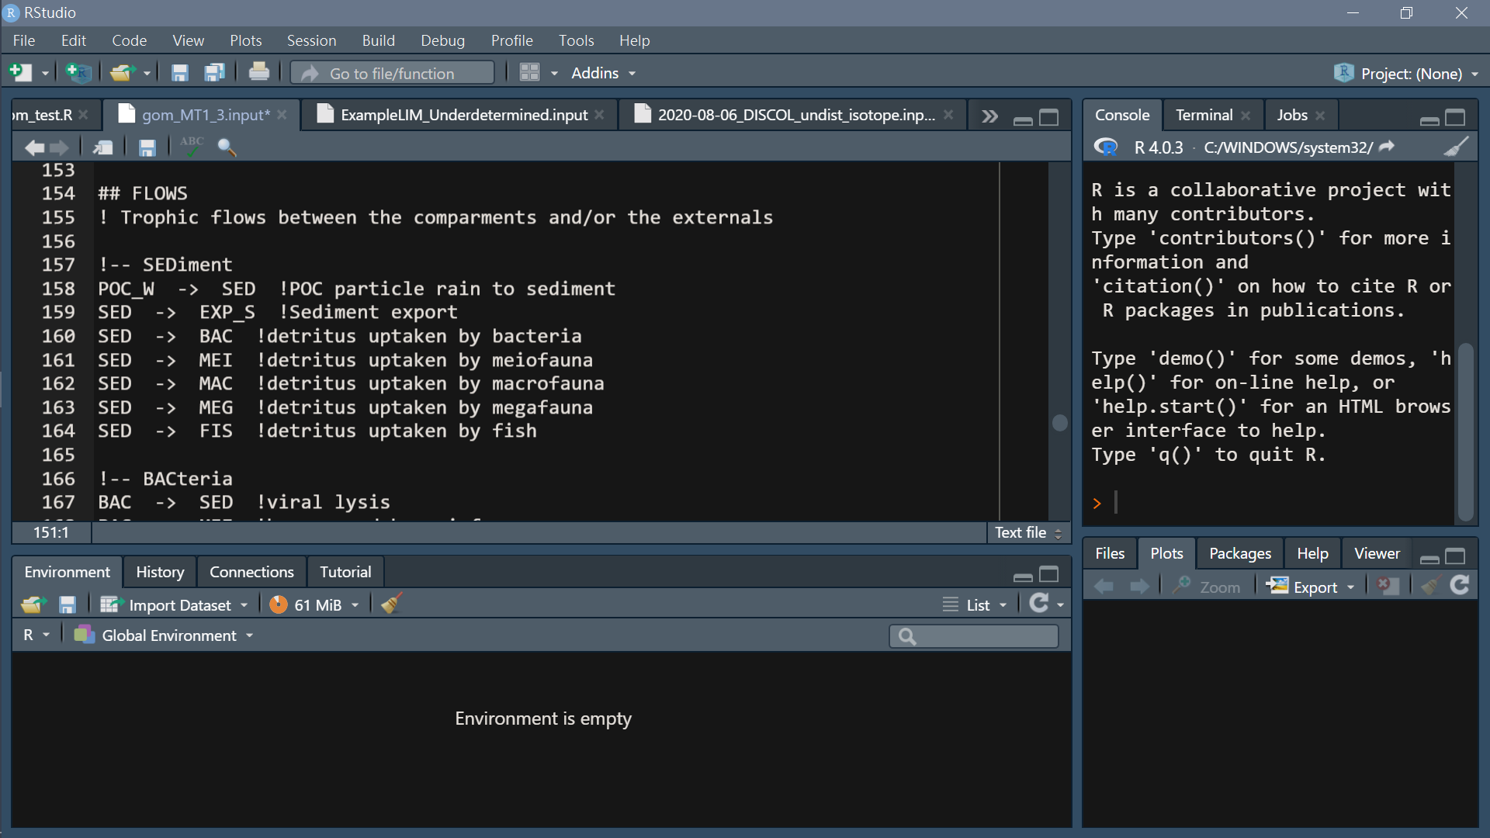
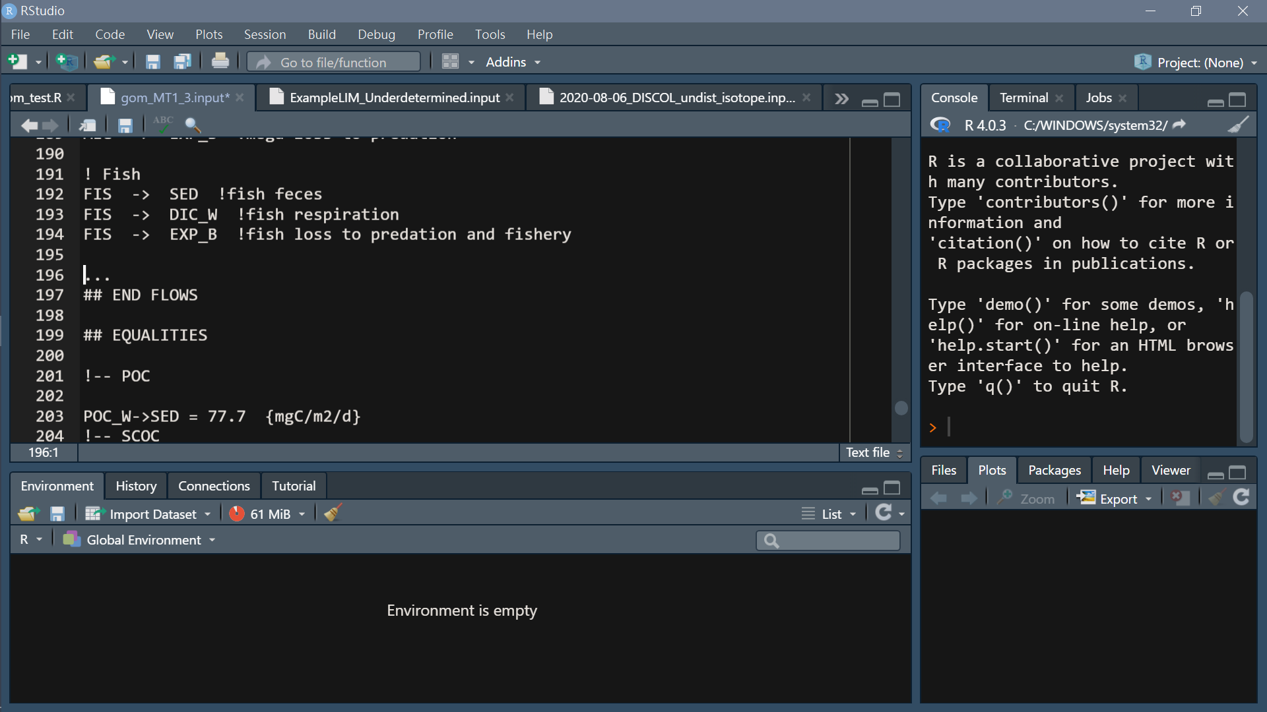
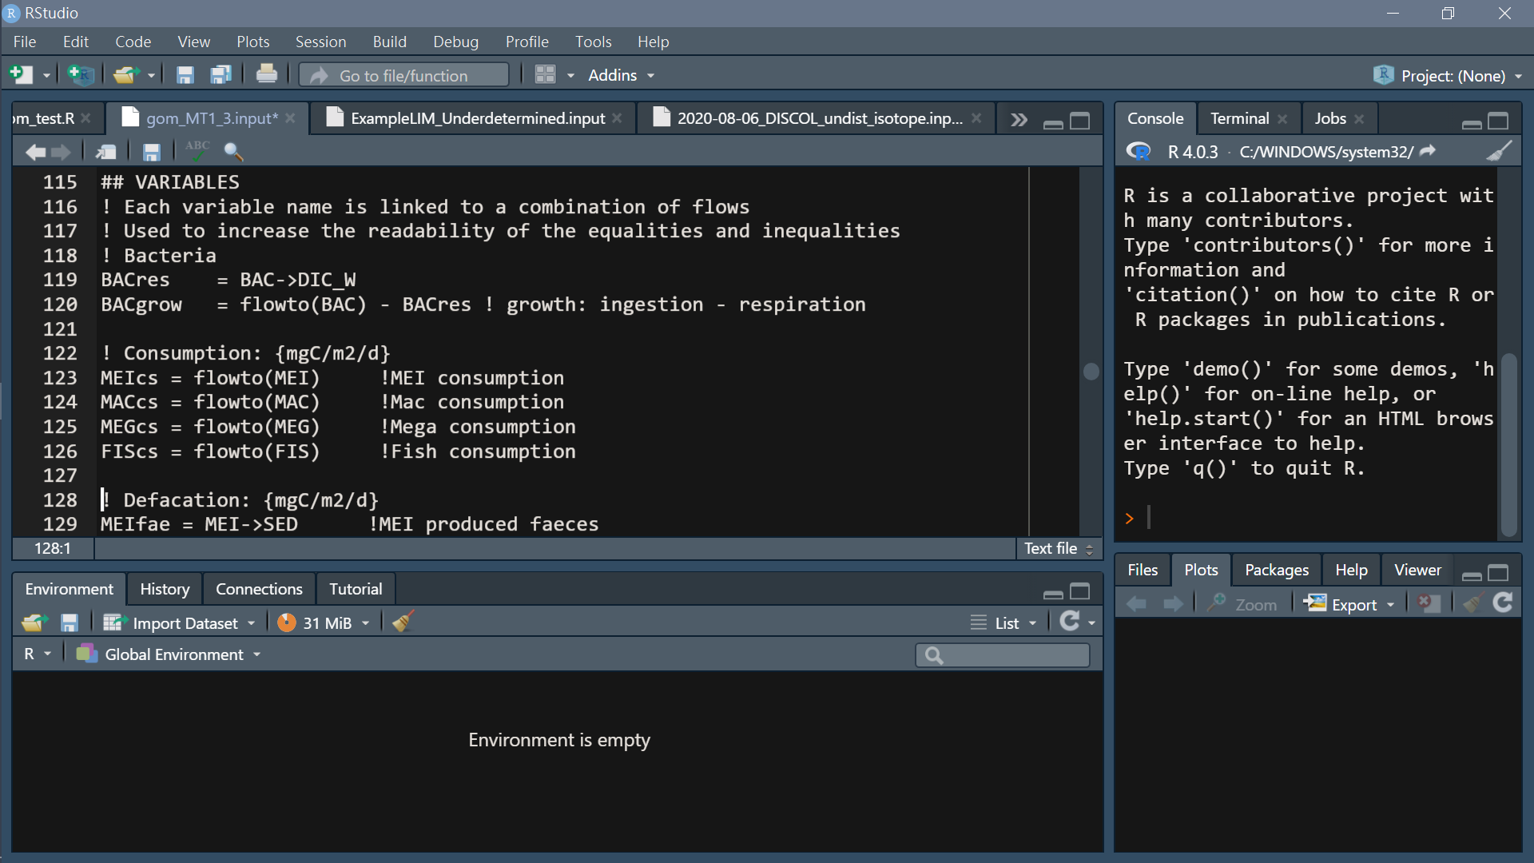
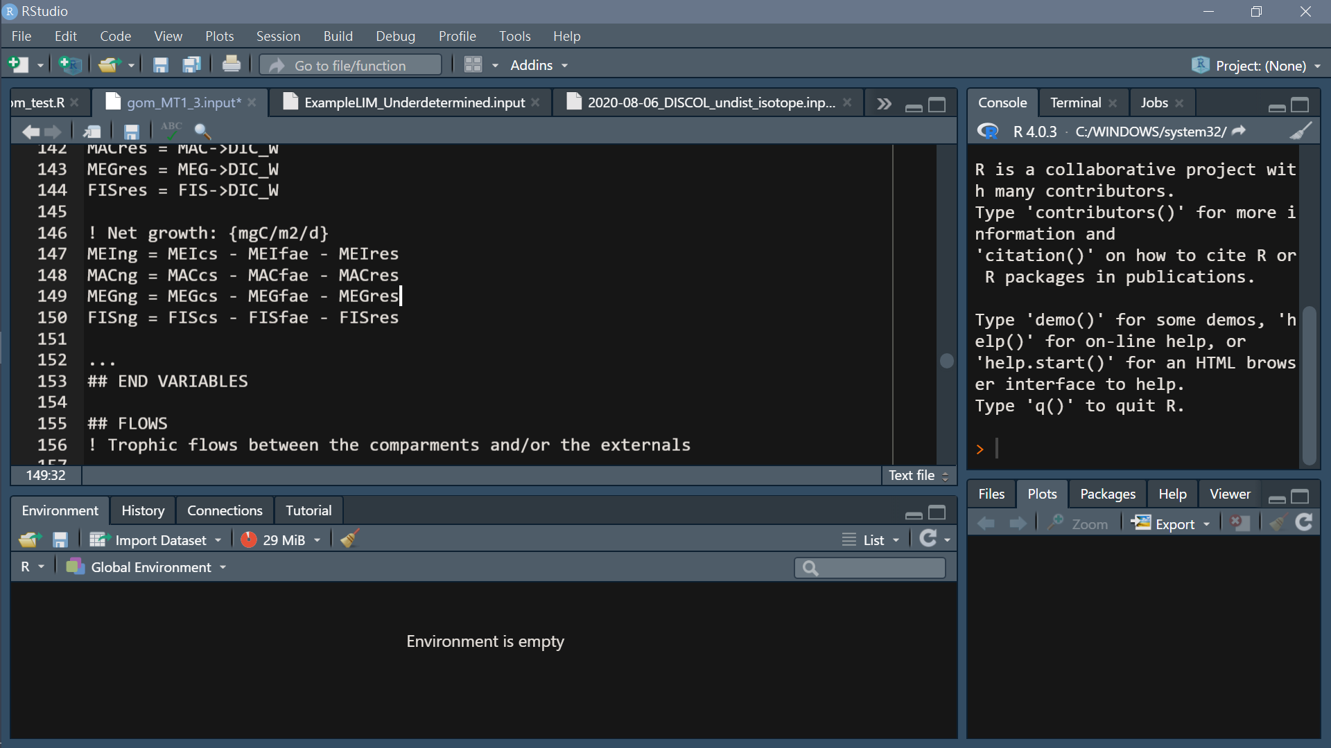
Headers (specified)
flow
Headers (specified)
Variable
Name a flow

Slide 14
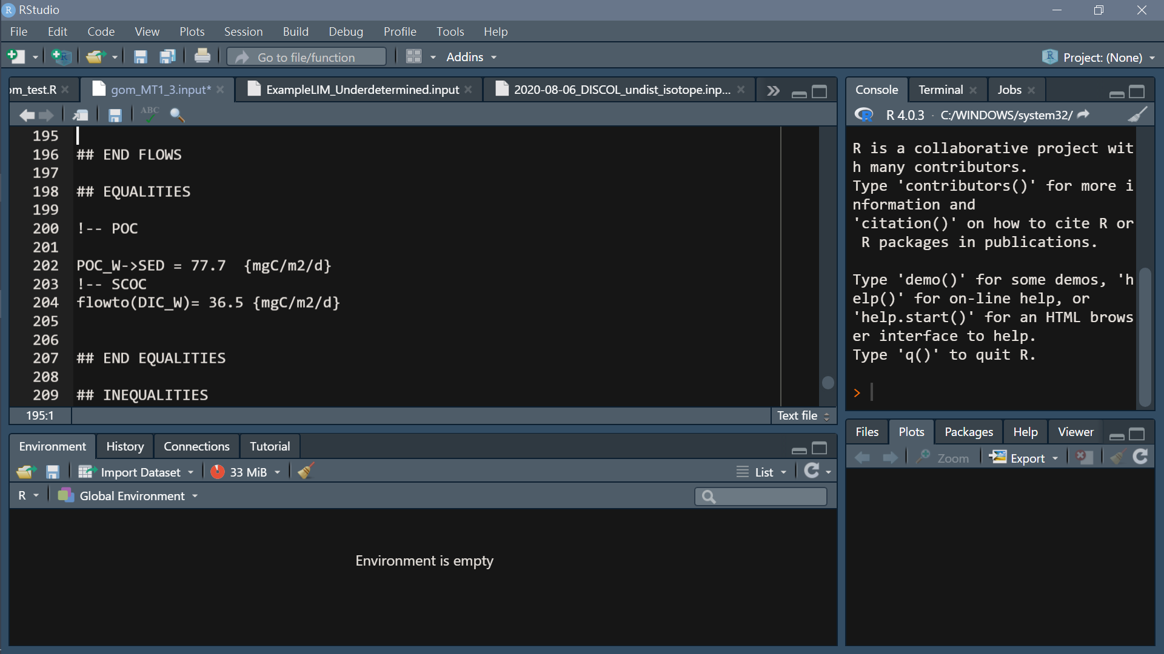
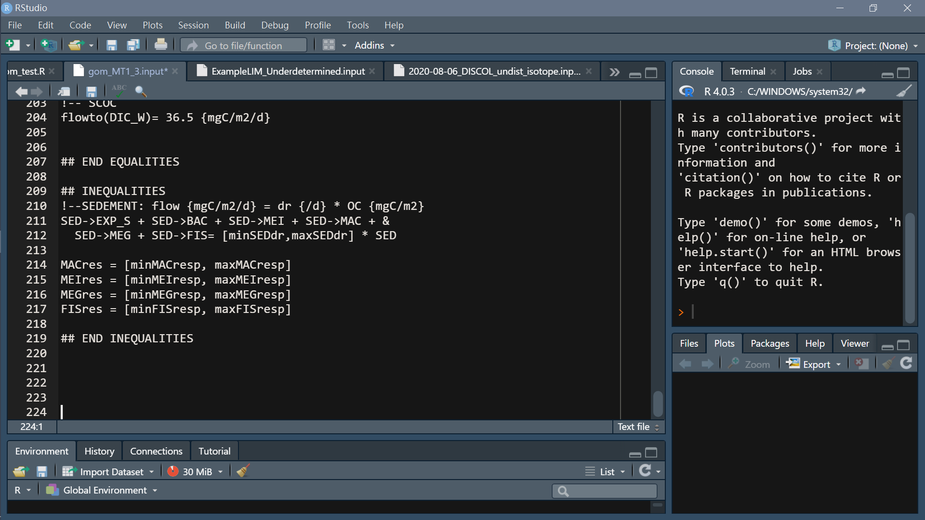
Headers (specified)
7. Equalities
Headers (specified)
Inequalities
Simple calculation: +, -, *, /
() not allowed
&: intend to next line
[min, max]: constraint

Slide 15
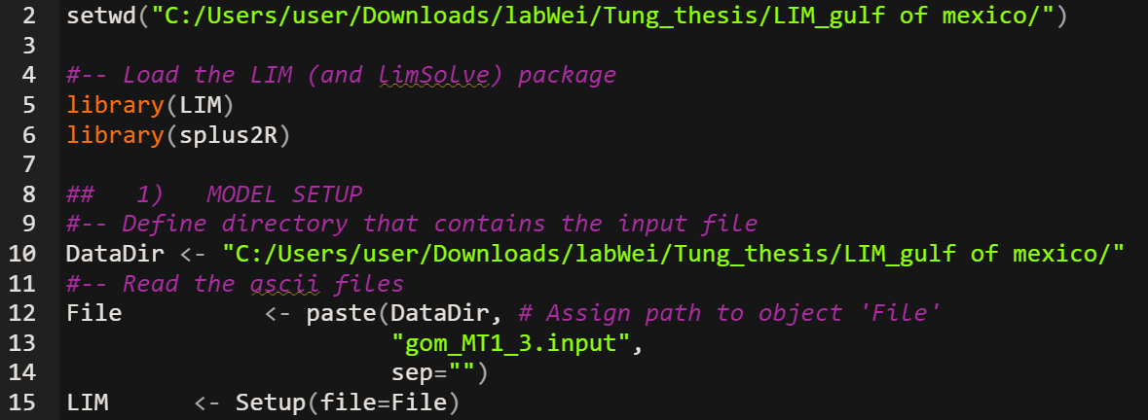
Run model with LIM
Load input file
Setup(): made everything in input file into matrix form

Slide 16
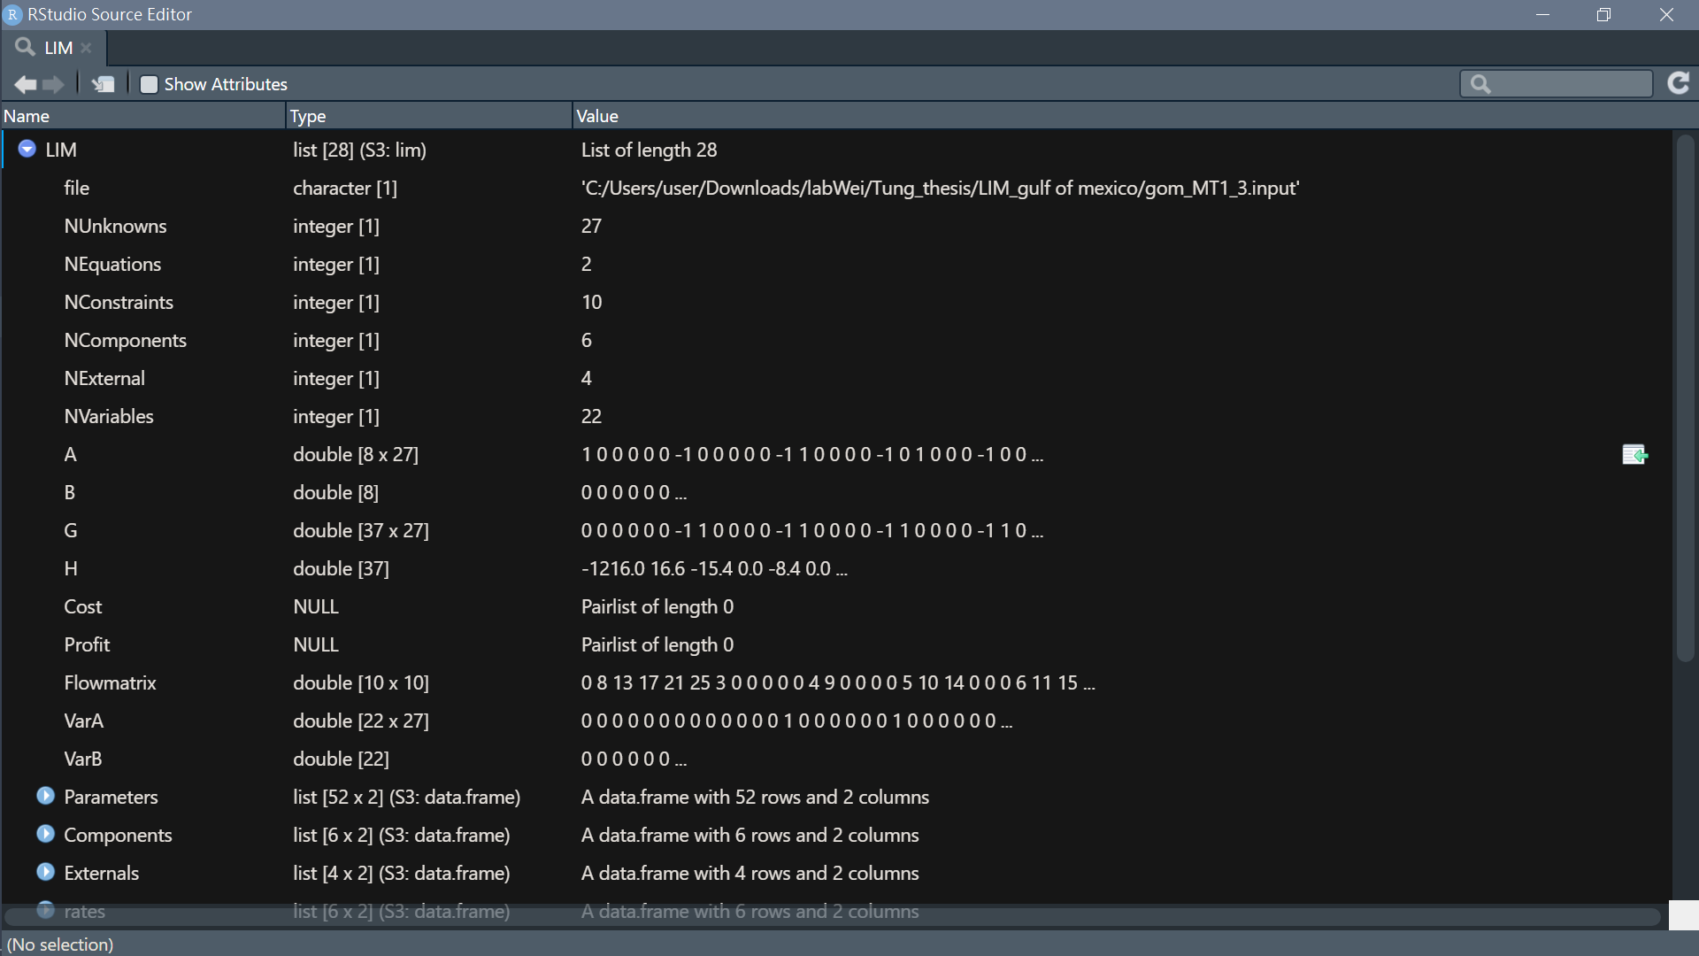
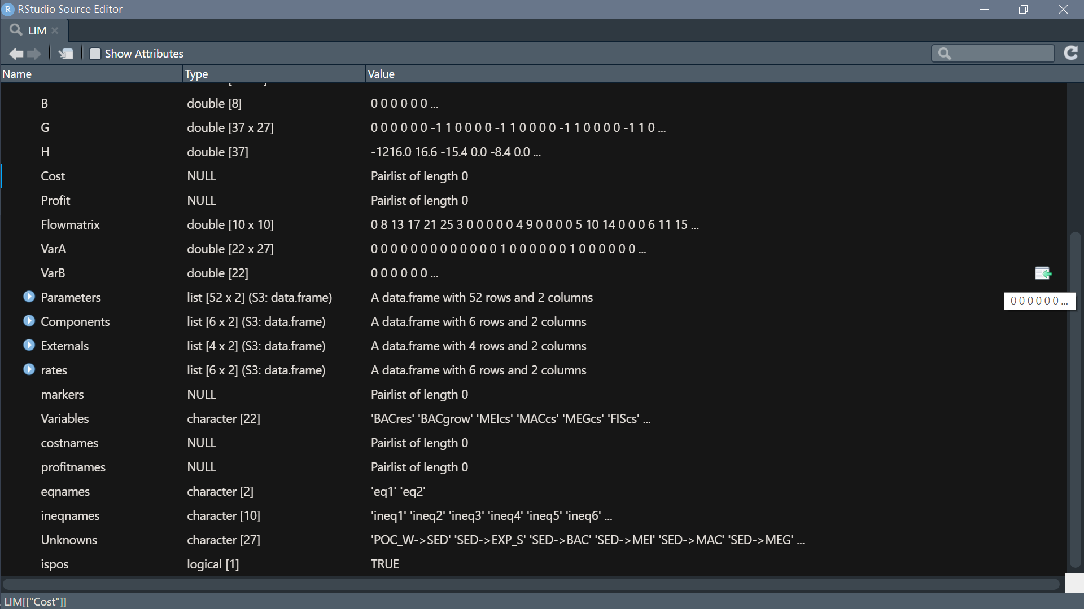

Slide 17
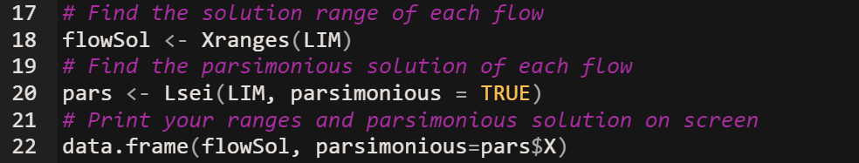
Single value (traditional food web)
Lsei(): Solves an lsei inverse problem (Least Squares with Equality and Inequality Constraints): min(||Ax-b||^2)
subject to Ex=f and Gx>=h
The parsimonious solution:
not based on any solid ecological theory
more objective to try to find the most likely solution

Slide 18
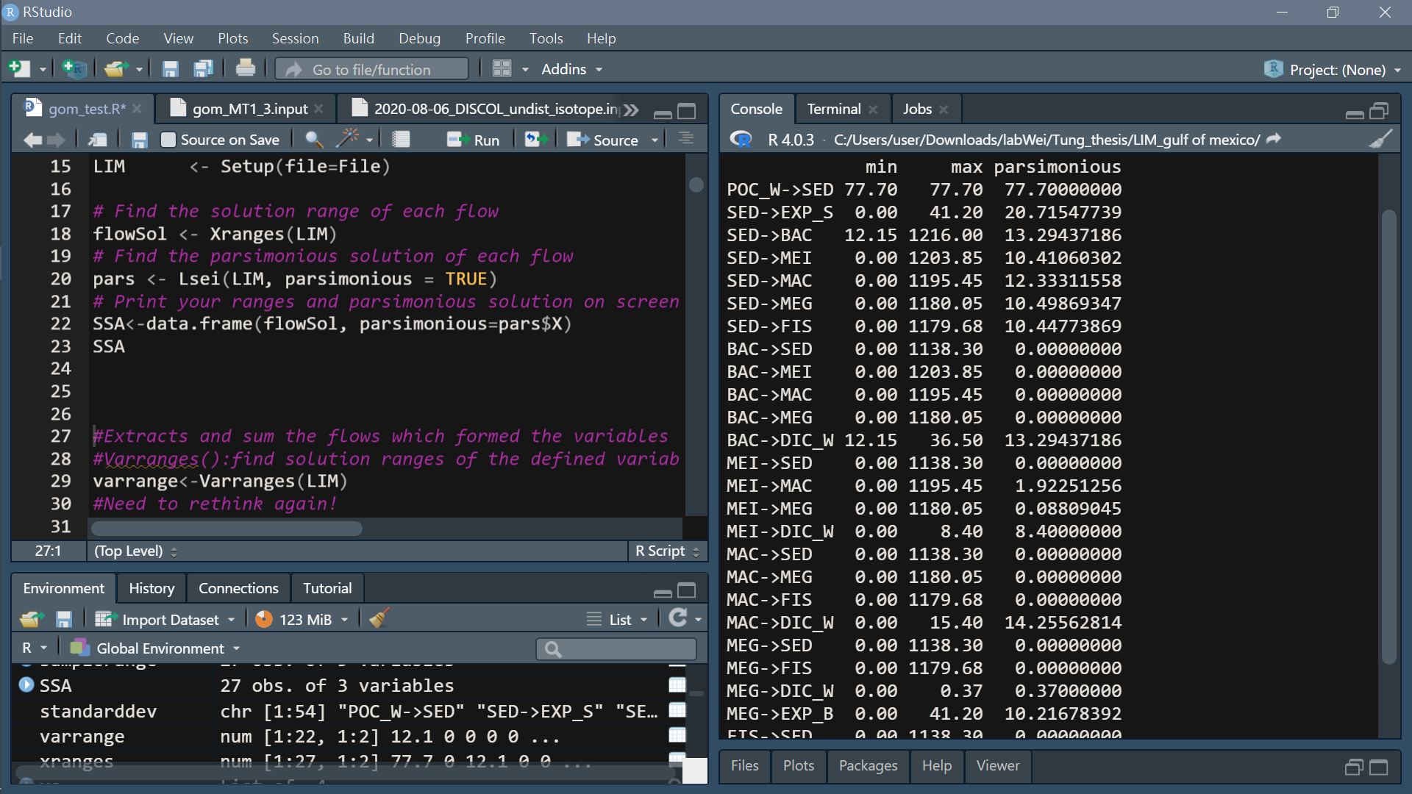
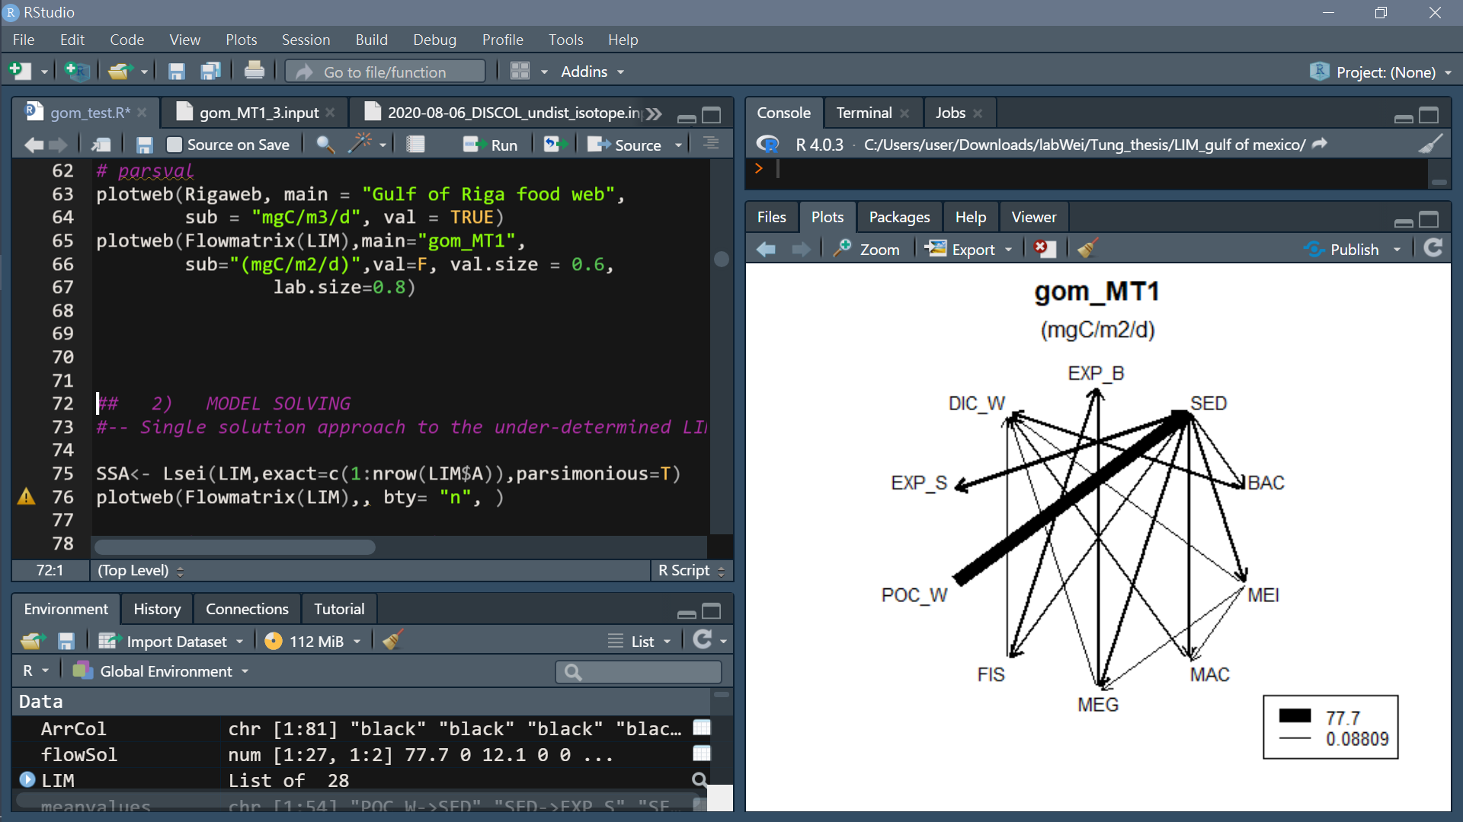
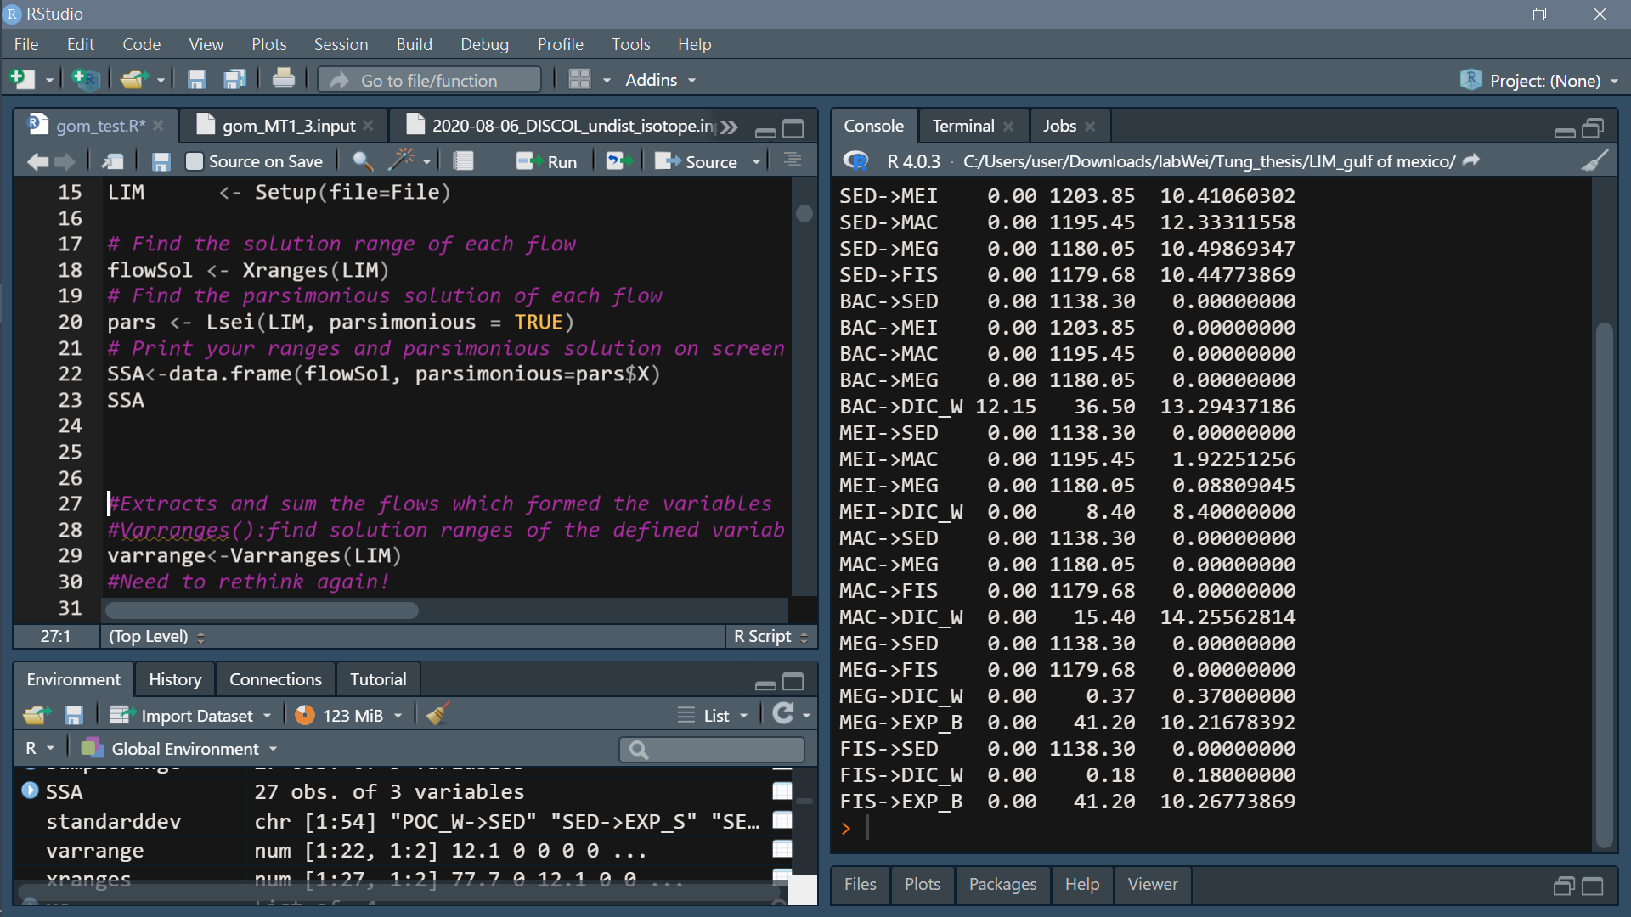

Slide 19
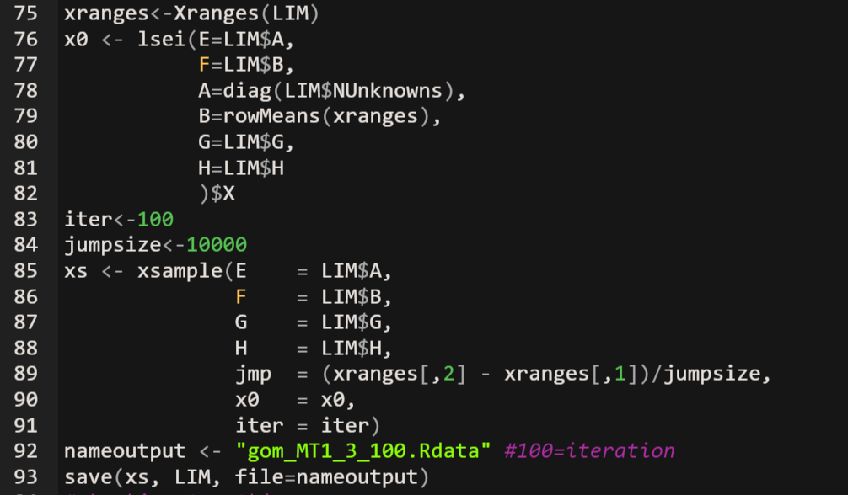
How the likelihood approach works:
we have found the ranges of solutions for every unknown flow.
These ranges are the edges of a multidimensional ‘solution space’.
The algorithm will randomly sample this solution space a lot of times, create a probability distribution with these samples
give you the most likely solution including the error margin.

Slide 20
Find suitable parameter: inequalities cannot be contradicted
(before run both SSA and likelihood model)
Likelihood method SOP:
Decide iteration & actual jumpsize(=range/jumpsize) -> run
Find mean & sd for each flow draw converge plot
Check coverage of solution space
Increase actual jumpsize & Increase iteration -> run
repeat

Slide 21
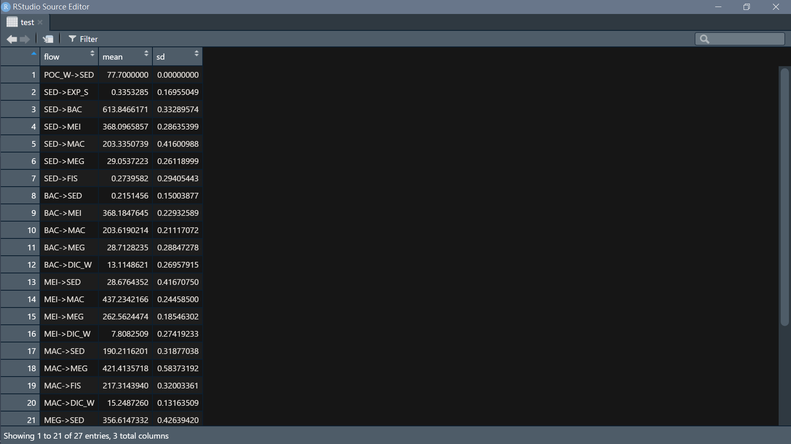
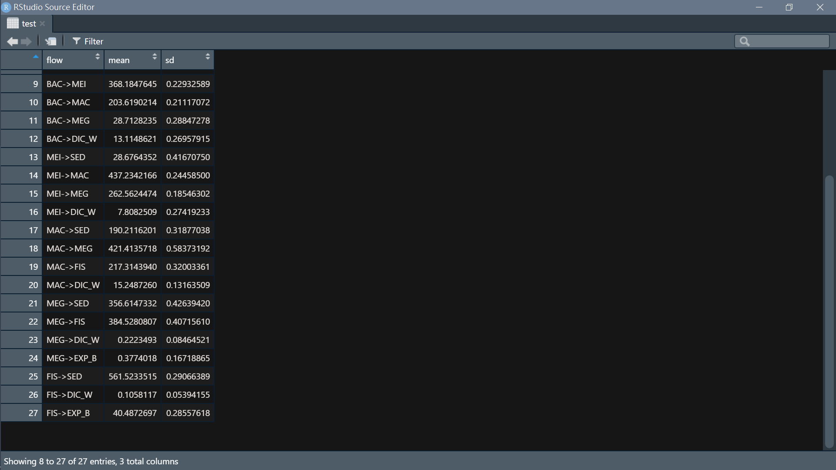
Result from likelihood method
Test 1:
iter<-100
jumpsize<-10000 (actual jumpsize= (max of range- min of range) /10000

Slide 22
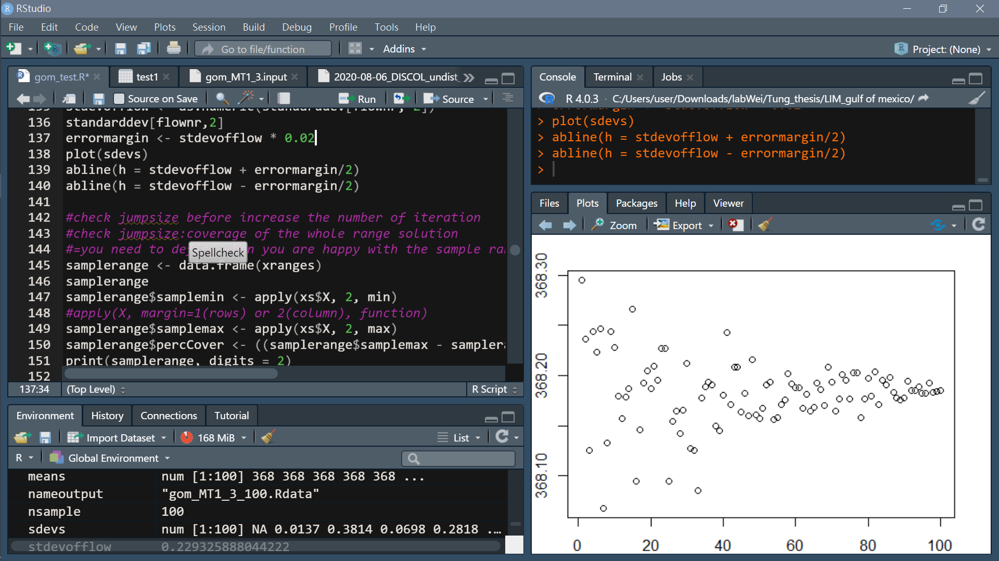
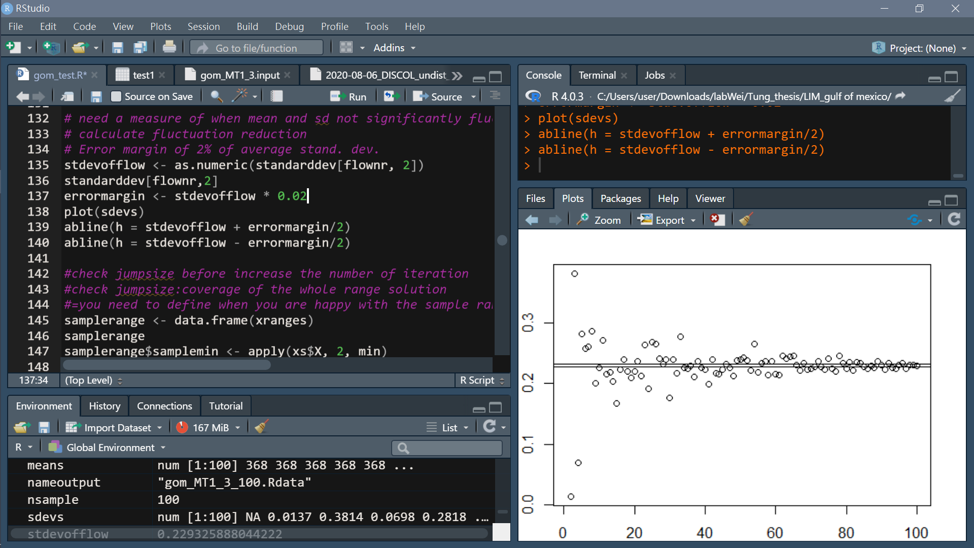
Converge plot
need a measure of when mean and sd not significantly fluctuate anymore
calculate fluctuation reduction
Error margin of 2% of average stand. dev.
Take BAC->MEI for example:
Mean
SD
Iteration
Iteration

Slide 23
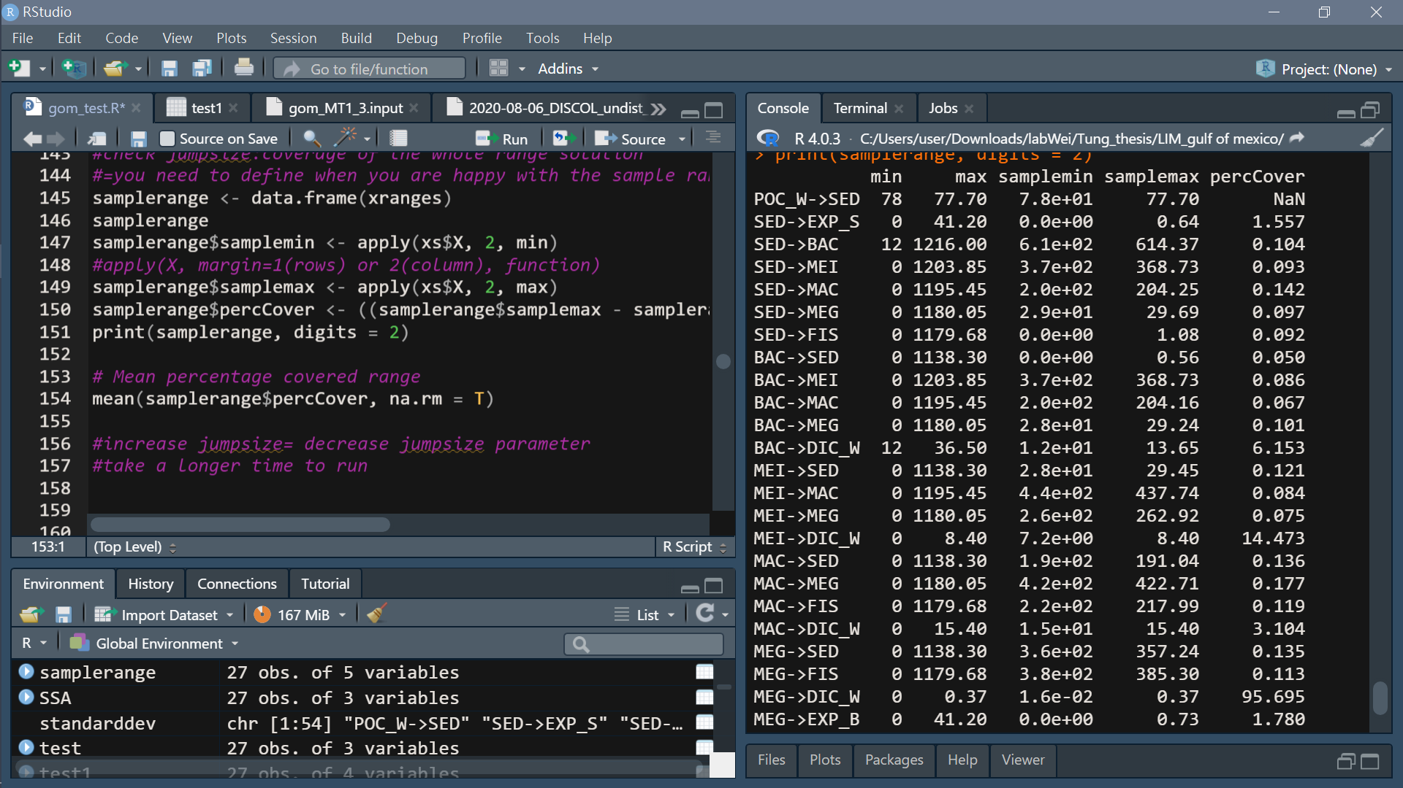
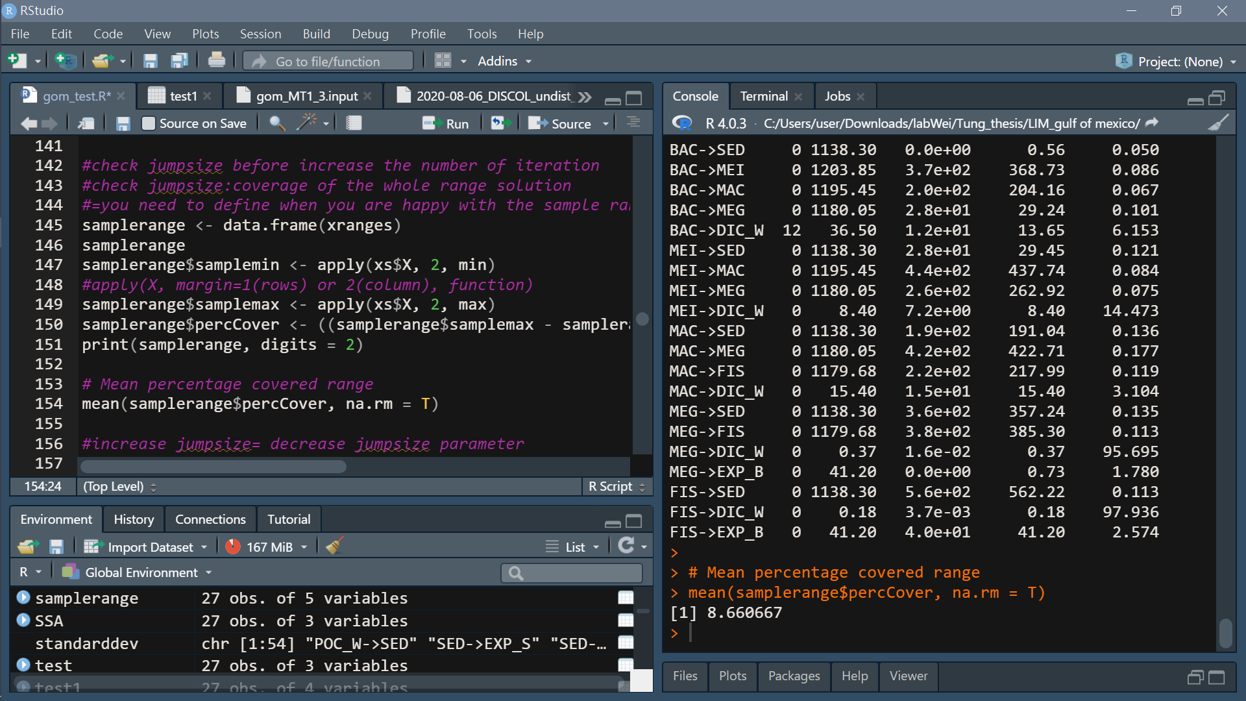
Check coverage of solution space

Slide 24
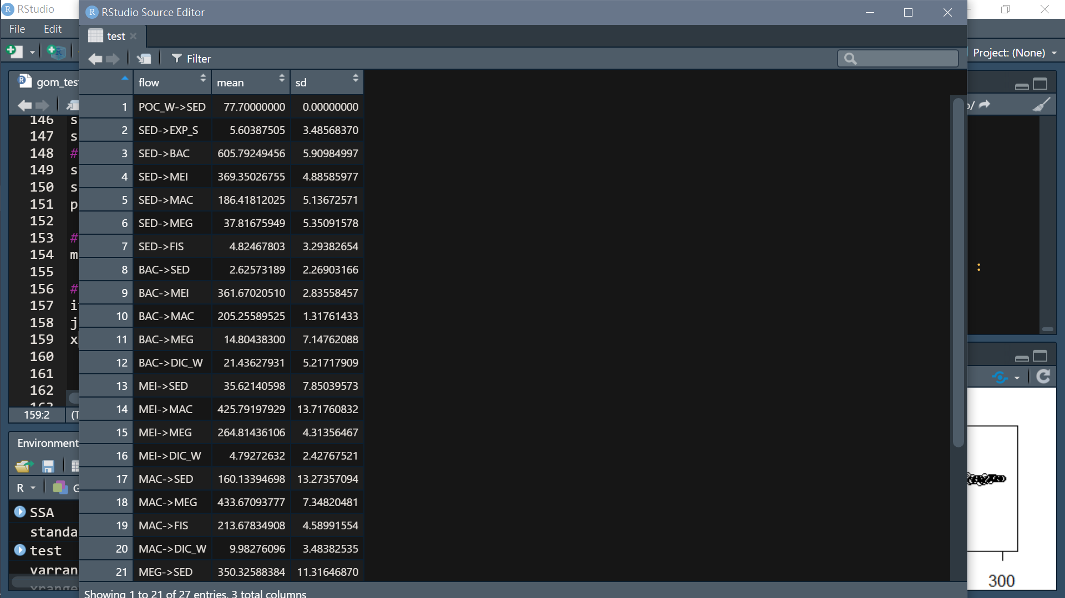
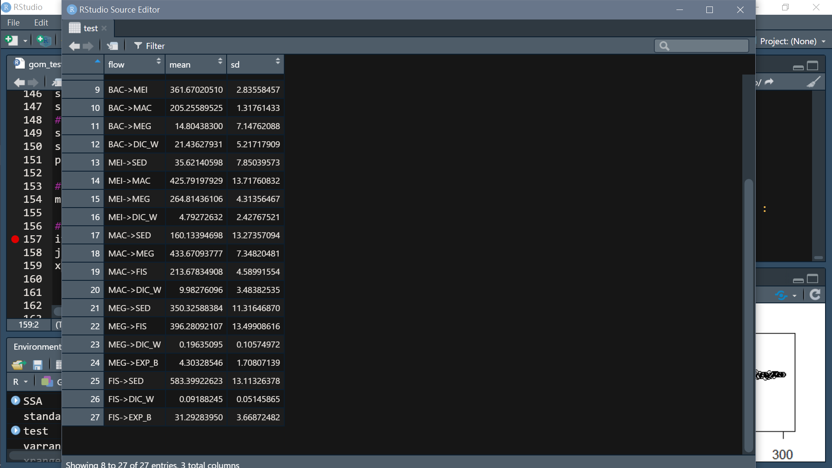
Test 1:
iter<-300
jumpsize<-1000 (actual jumpsize= (max of range- min of range) /1000

Slide 25
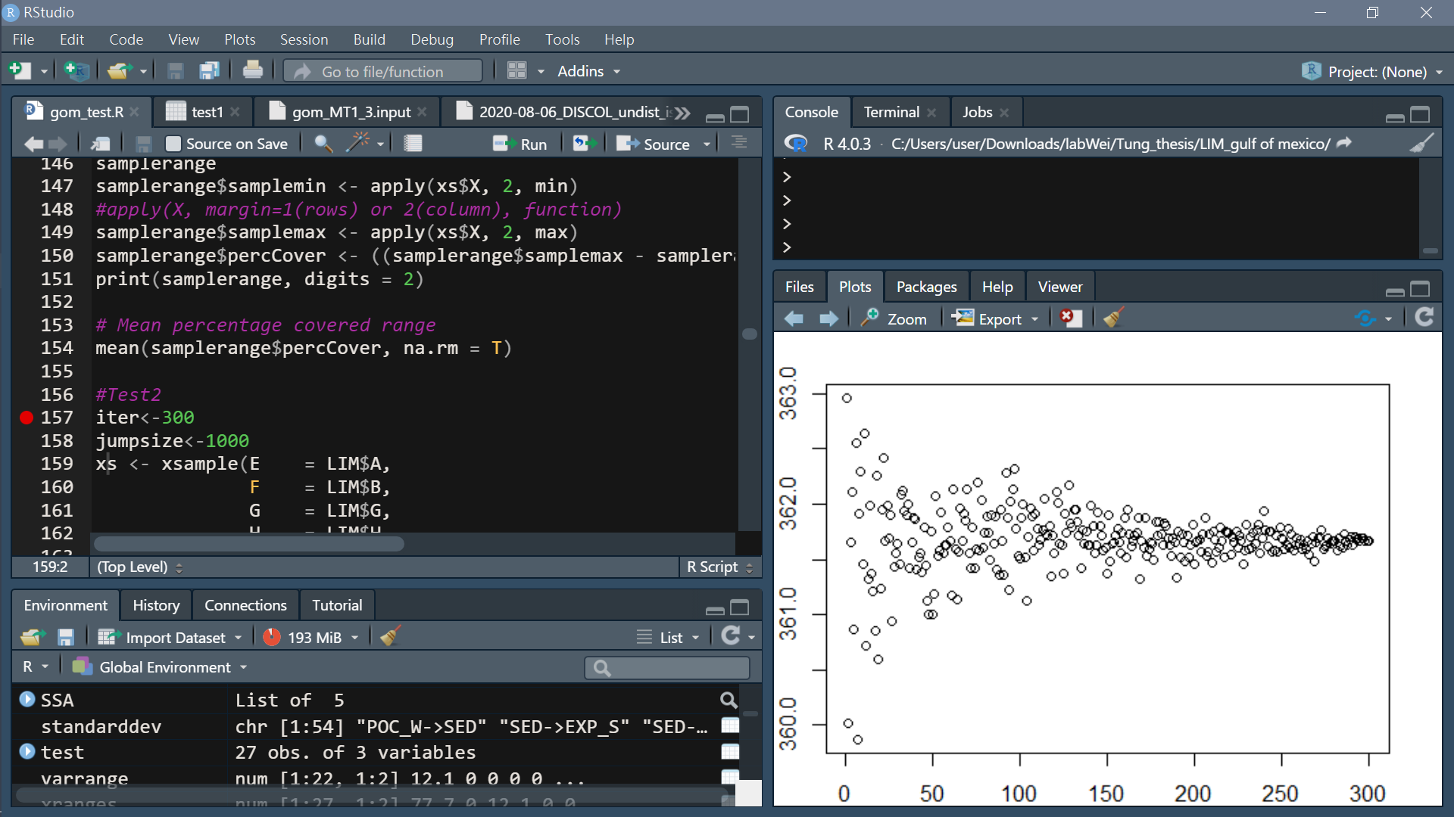
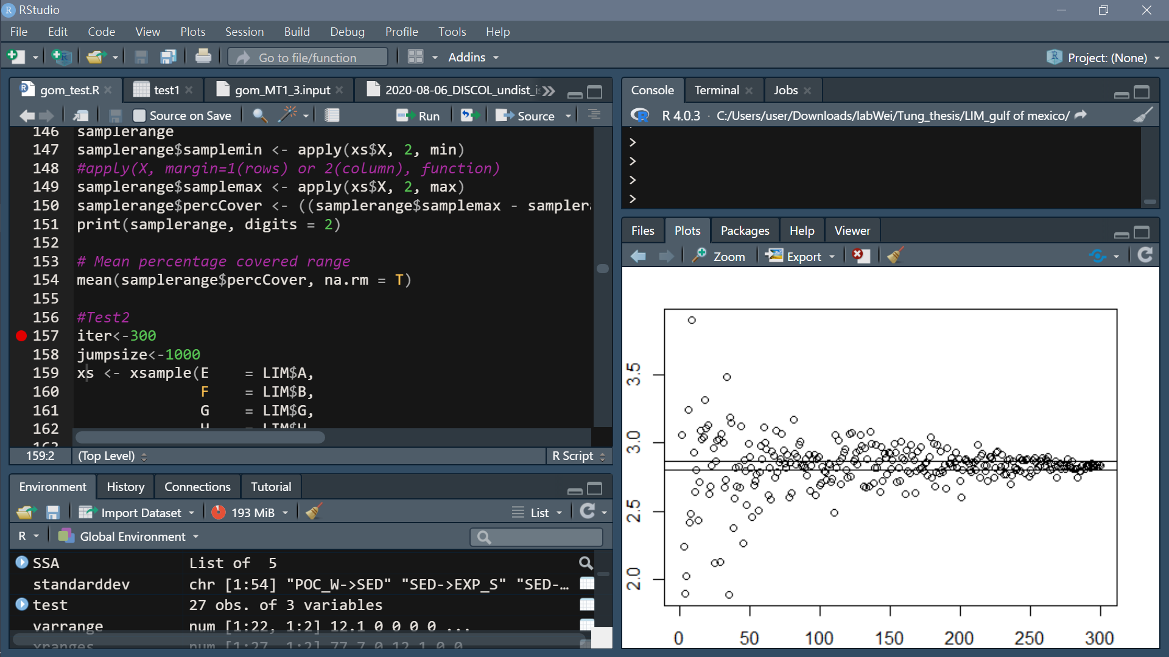
Converge plot
need a measure of when mean and sd not significantly fluctuate anymore
calculate fluctuation reduction
Error margin of 2% of average stand. dev.
Mean percentage covered range
[1] 23.9333
Take BAC->MEI for example:
Mean
SD
Iteration
Iteration

Slide 26
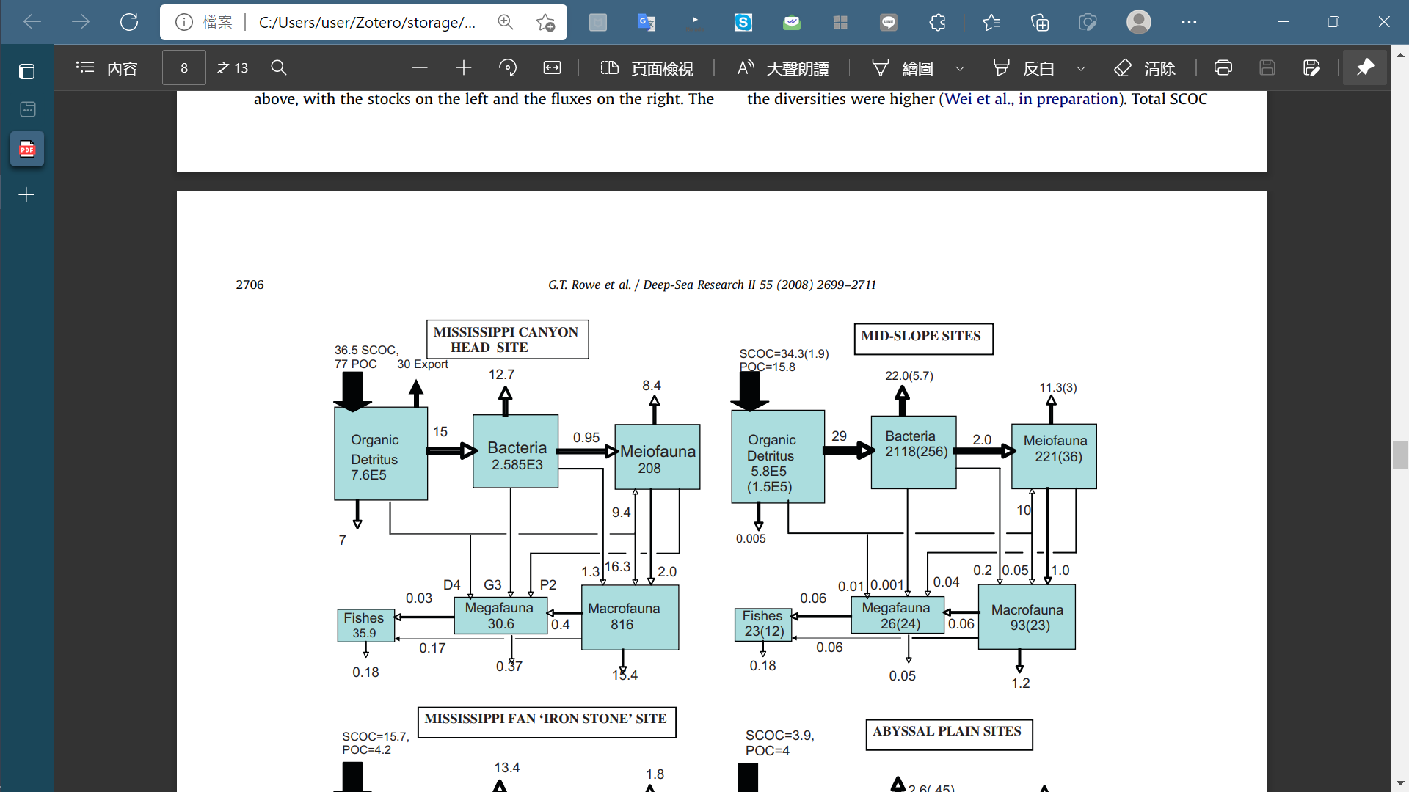
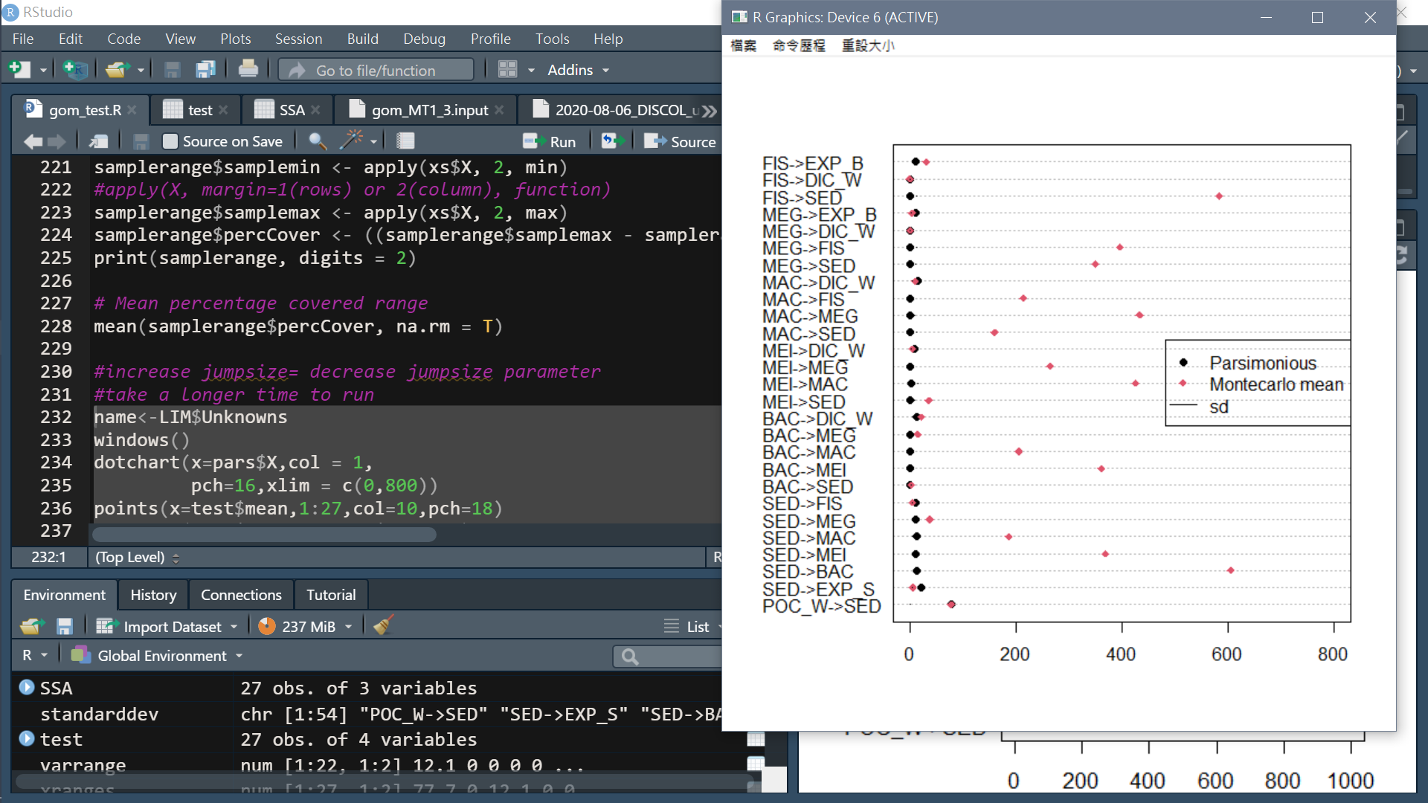
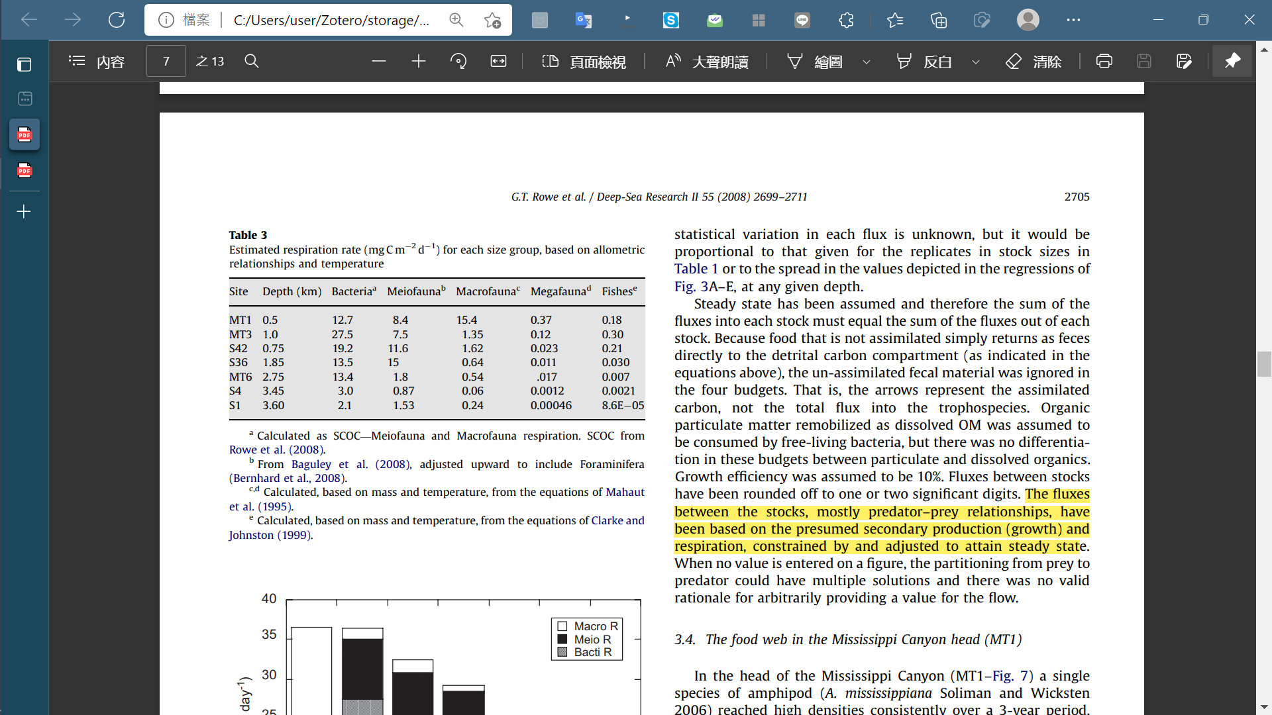
Compare parsimonious, likelihood result and Rowe et al. (2008)
Flow (mgC/m2/d)

Slide 27
Problem:
In this trial, I directly used calculated respiration rate and did not use physiological constraints from references (because of contradictory) so the values of flow rate were quite large
Fix inequalities: assume growth efficiency as 10% (Rowe et al. 2008)
Do not use calculated respiration rate and use physiological constraints from references
Including respiration rate

Slide 28
Benthopelagic fish | Respiration(ml O2/hr)/per kg wet weight | Temp | reference
Coryphaenoides acrolepis | 2.4 | 3.5 | Smith and Hessler 1974
 | 3.7 | 3 | Smith 1978
 | 3.1 | 3 | Smith 1978
 | 2.7 | 3 | Smith 1978
 | Y = aW^b, Y=respiration,(ul O2/h) and W=wet wt (mg) | 3 | Smith and Laver, 1981
Eptatretus deani | 2.2 | 3.5 | Smith and Hessler, 1974
Epibenthic Echinoderms | Population O2 consumption rate (ulO2/m2/hr)
Ophiophthalmus normani | 1129.28 | 3 | Smith 1983
Scotoplanes globosa | 1.38 | 3 | Smith 1983
Gx≧h
respiration rate
Phase | a | b
Resting (1979/6/24) | 0.61 | 0.47
active | 0.66 | 0.69
Resting (1979/6/24) | 0.26 | 0.62

Slide 29
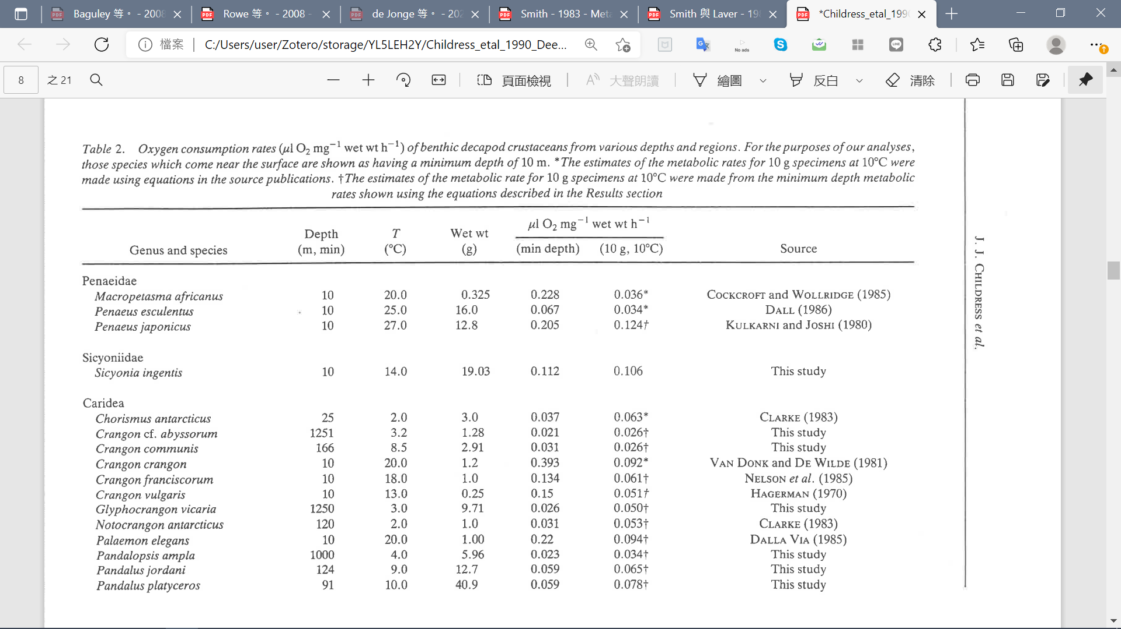
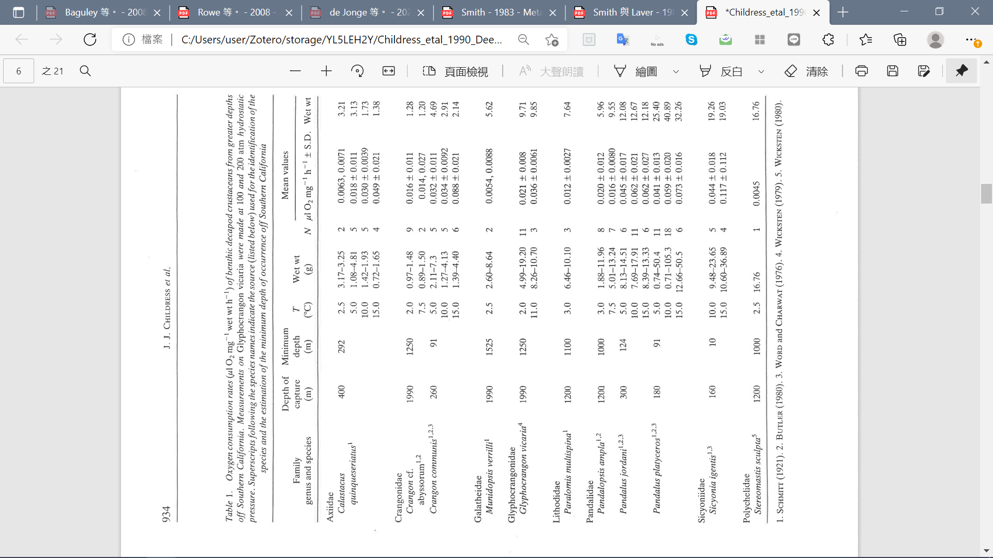
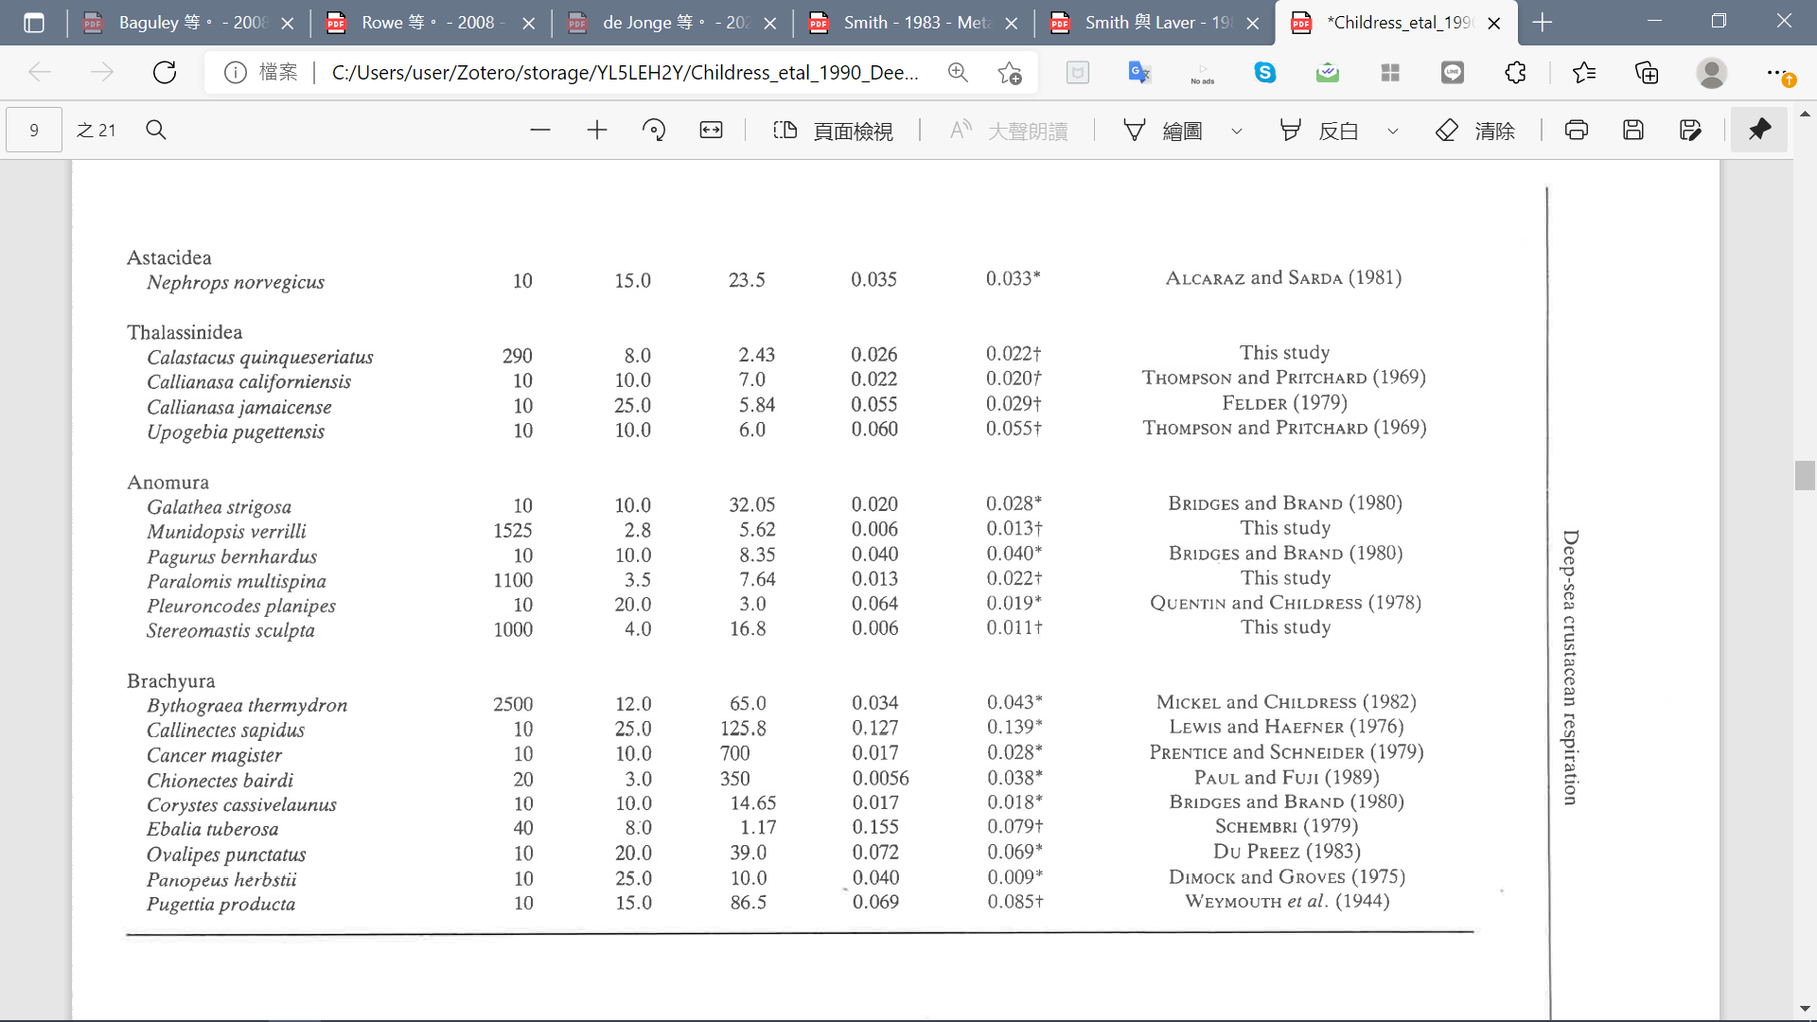
Gx≧h
(Childress et al., 1990)

Slide 30
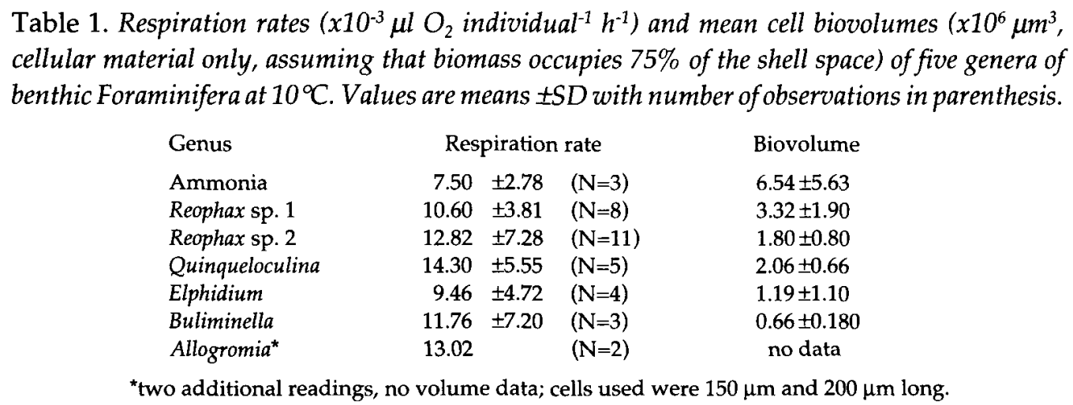
(Hannah et al., 1994)
Average respiration rate: 11.3*10-3(ulO2/h) regardless of genus
Gx≧h
For the macro-and megafauna, respiration rates, valid at temperatures of 2–4°C, were estimated as: R=0:0074 W^-0.24 (Mahaut et al., 1995).
The for each size category or ‘‘trophospecies’’ in the equations has been estimated from literature values( ; Piepenburg et al., 1995; Heip et al., 2001; Rowe et al., 2003; Baguley et al., 2008)
Piepenburg et al. (1995) used shipboard SCOC measures in conjunction with weight-specific estimates for meio-, macro- and megafauna to arrive at a respiration budget for the shelf-upper slope of arctic stations
Growth efficiency (growth/ assimilated carbon 100) was assumed to be 10% throughout. The general strategy was to create the most parsimonious predator–prey relationships possible, given the stock sizes, respiration and production, to achieve steady state. The most productive prey dominated as source terms for the predators (Jorgensen et al., 2002).
The governing principle has been to transfer all the production from a prey to the next consumer (Jorgensen et al., 2002), but when (if) that production of the prey was greater than the demand of the next level, then the excess was split among other potential consumers at the next level. If the production was too low to supply the demand of the next level, then other sources lower in the web, such as detritus and bacteria, were included, as available. In no case did a ‘‘smaller’’ category consume a ‘‘larger’’ group.

Slide 31
bacterial production: BGEdet · det → bac
Bacteria production rate (mgC/m2/d )
S42: 4.6
MT3: 6.3
S36: 14.8
Deming& Carpenter (2008)

Slide 32
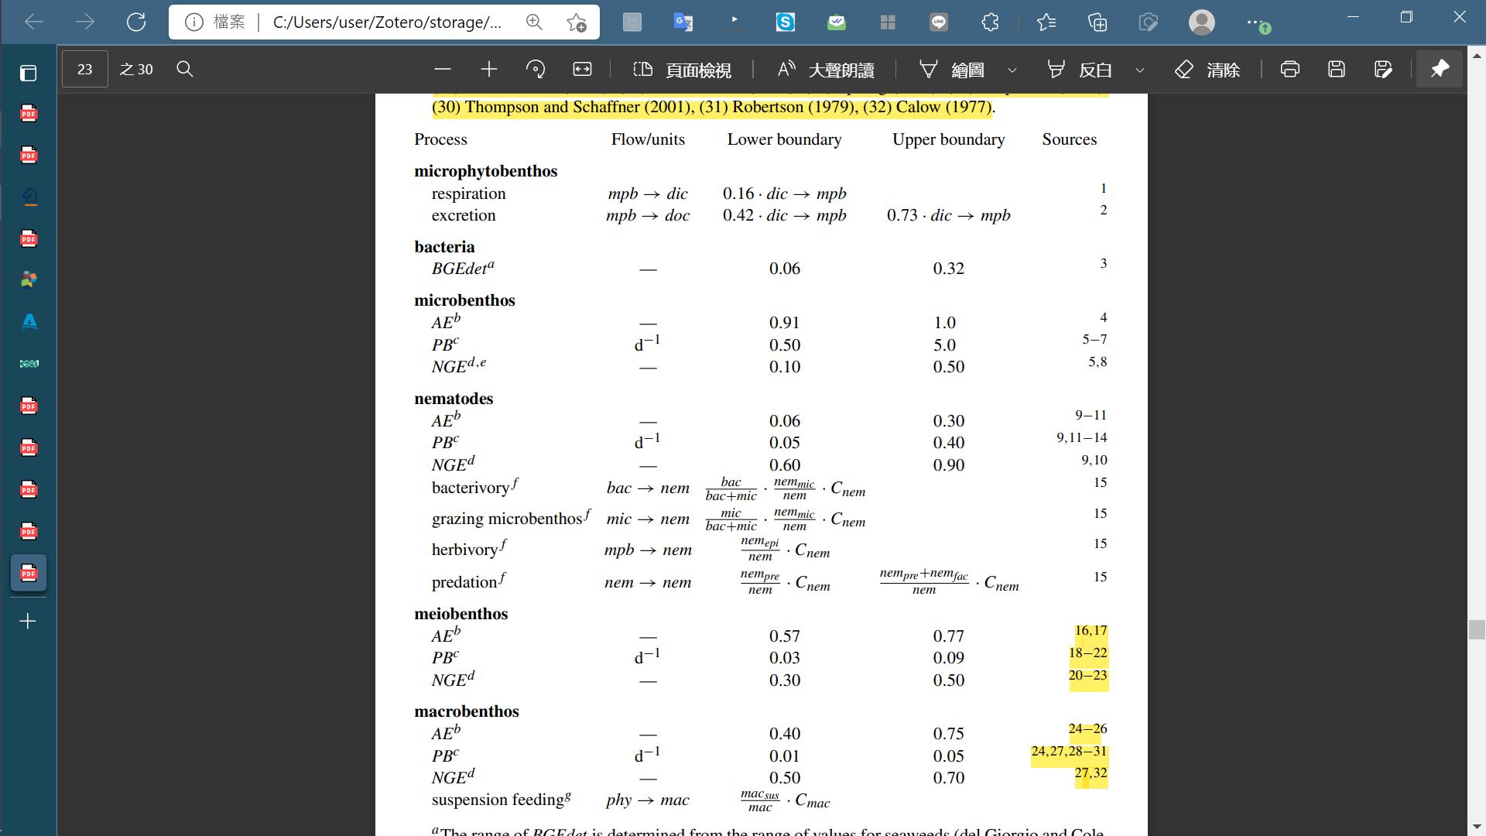
van Oevelen 2006
Molenplaat intertidal flat
Review papers
Banse and Mosher (1980)Adult body mass and annual production/biomass relationships of field populations.
Heip et al. (1995) Production and consumption of biological particles in temperate tidal estuaries.
Robertson(1979) The relationship between annual production : biomass ratios and lifespans for marine macrobenthos. Oecologia, 38, 193–202
Calow (1977) Conversion efficiencies in heterotrophic organisms.

Slide 33
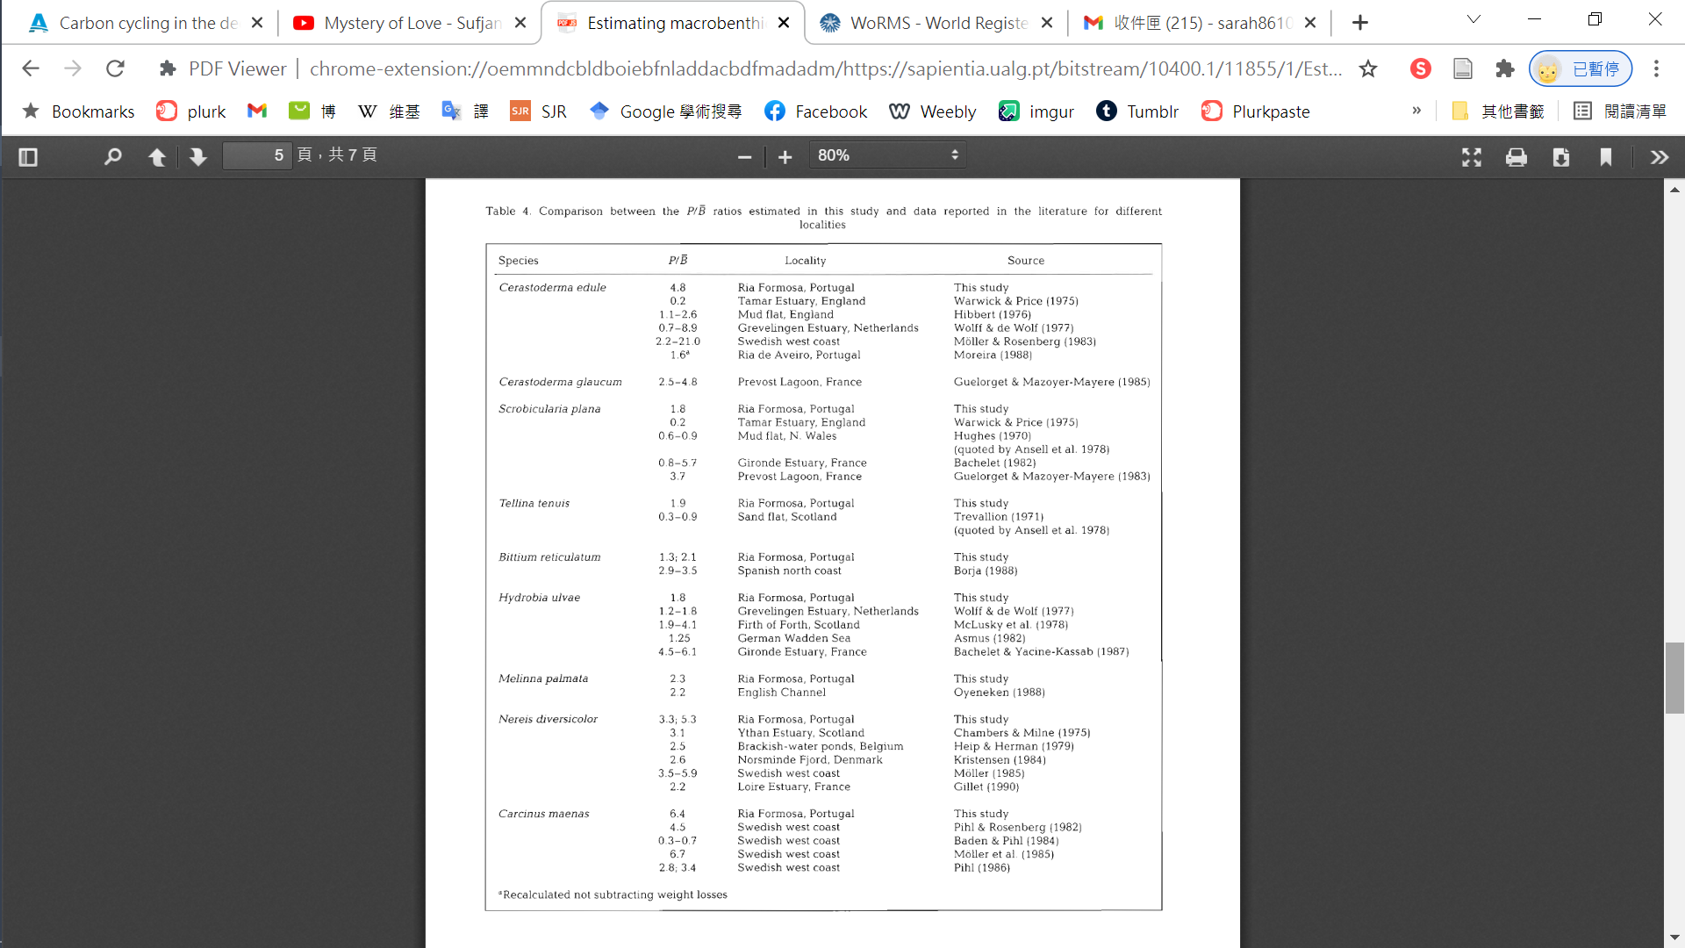
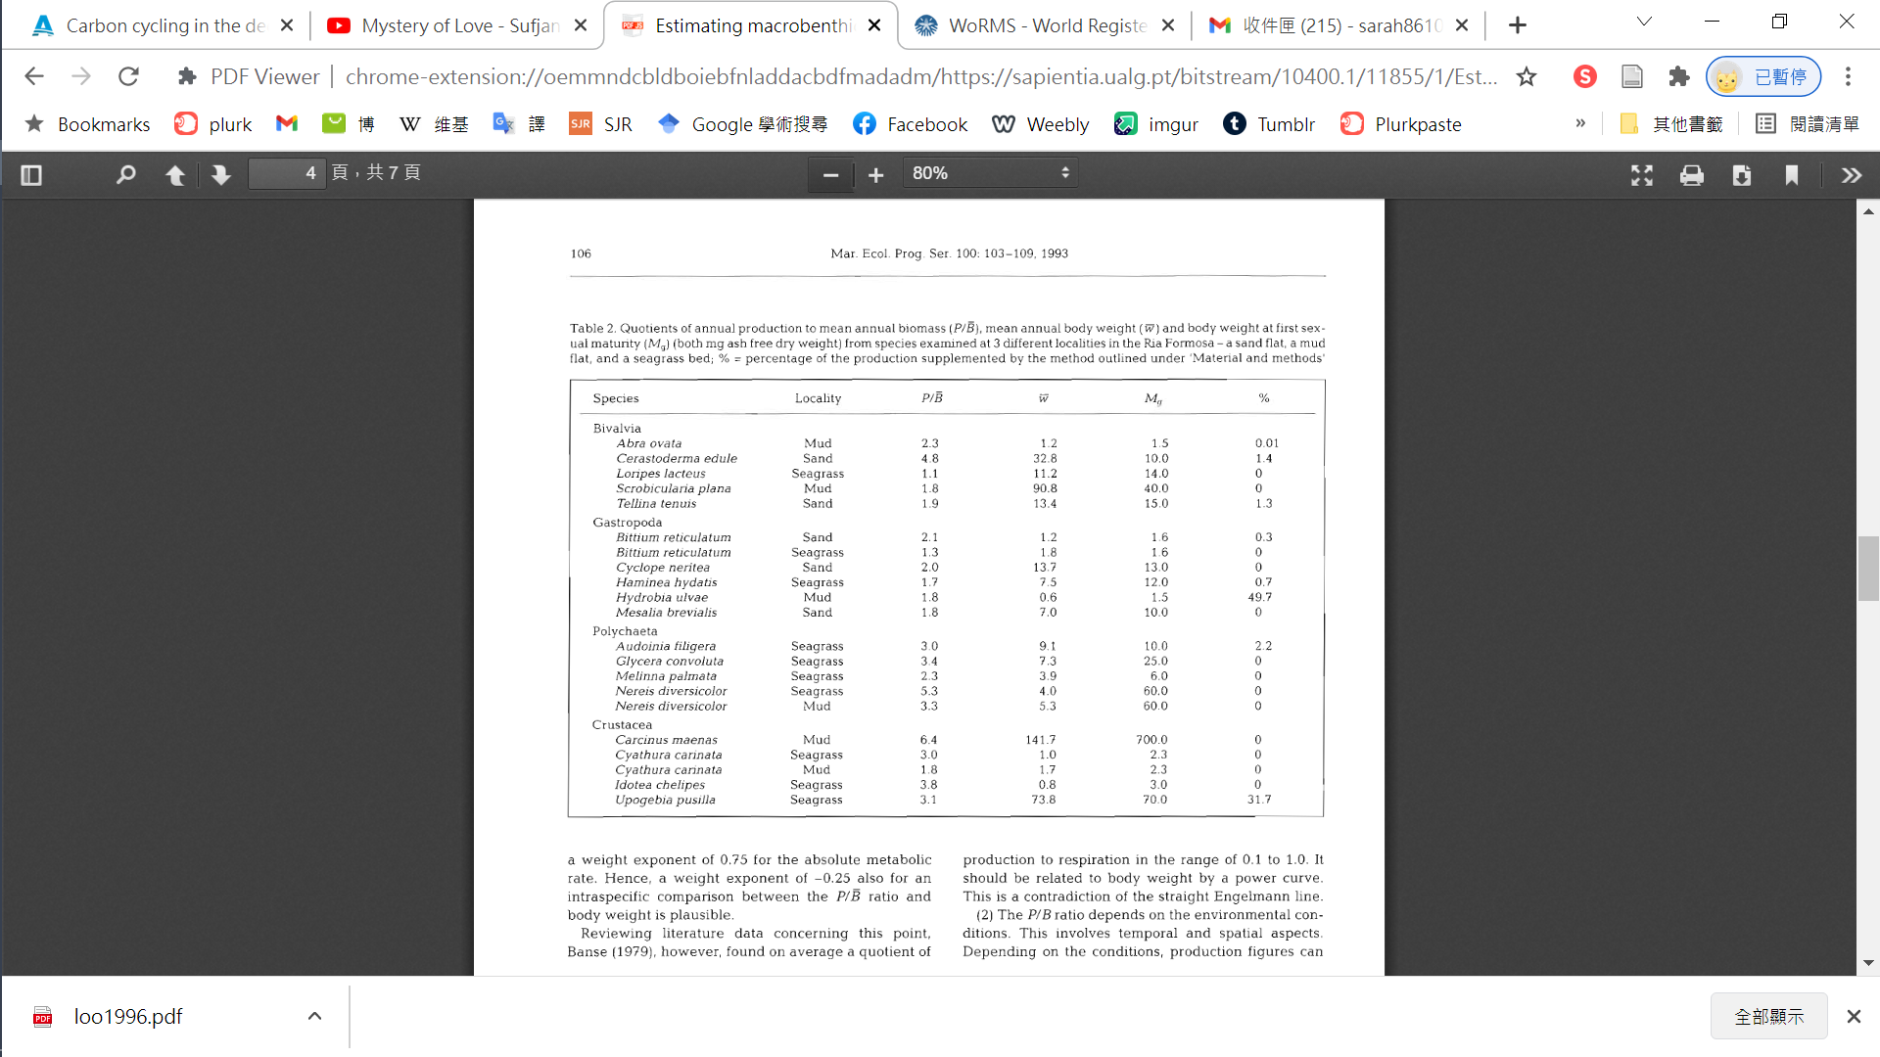
Sprung (1993), Estimating macrobenthic secondary production from body weight and biomass: A field test in a non-boreal intertidal habitat.

Slide 34
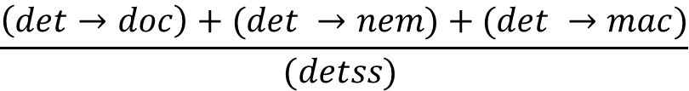


Gx≧h
Process
$$\frac{(doc→bac)−(bac →dic)}{(doc→bac) }$$
Min:0.02; Max:0.61 (del Giorgio and Cole, 1998)
Bacterial growth efficiency
In Gulf of Mexico
Detritus degradation rate(d⁻¹)
$$\frac{\left(det→doc\right)+(det →nem)+(det →mac)}{(detss) }$$
Min:0.00025; Max:0.016 (Henrichs and Doyle, 1986)
Nematodes
Growth rate(d⁻¹)
$$\frac{\left(det→nem\right)+\left(bac →nem\right)−\left(nem →det\right)−nemGR}{nemss}$$
Min: Tlim*0.05; Max: Tlim*0.4 (van Oevelen et al., 2006)
Macro benthos
$$macGR$$
Growth rate(d⁻¹)
$$\frac{\left(det→mac\right)+\left(bac →mac\right)+\left(nem →mac\right)−\left(mac →det\right)−[\left(mac →dic\right)−macMR]}{macss}$$
Min: Tlim*0.01; Max: Tlim*0.05 (van Oevelen et al., 2006)

Slide 35

$bsFR ratio$(d-1)
ulO2/mg/h*24=ulO2/mg/d
ulO2/mg/d*1.426=ugO2/mg/d
ugO2/mg/d*0.309=ugC/mg/d
ugC/mg/d*0.165=ugC/mgC/d=10-3(d-1)
ml O2/hr/per kg wet weight*24=mlO2/kgwm/d
mlO2/kgwm/d*1.426=mgO2/kgwm/d
mgO2/kgwm/d*0.309=mgC/kgwm/d
mgC/kgwm/d*0.165=mgC/kgC/d= 10-3(d-1)
NGE=P/(P+R)
P=consumption-feces-maintain res
R = [min,max] × carbon stock

Slide 36



Literature constraints
Carbon flows between faunal compartments are constrained by various minimum and maximum process rates and conversion efficiencies.
Value | Min | Max | Reference
Macrofauna | 0.62 | 0.87 | Stratmann et al., 2018
Megafauna | 0.48 | 0.80
Fish | 0.84 | 0.87 | Drazen et al., 2007
Macrofauna | 0.60 | 0.72 | Clausen and Riisgård, 1996; Navarro et al., 1994; Nielsen et al., 1995
Megafauna | 0.48 | 0.60 | Koopmans et al., 2010; Mondal, 2006; Nielsen et al., 1995
Fish | 0.37 | 0.71 | Childress et al., 1980
Assimilation efficiency
$$\frac{\sum{consumption}−\sum{feces}}{\sum{consumption}}$$
Net growth efficiency
$$\frac{\sum{consumption}−\sum{feces−\sum{respiration}}}{\sum{consumption}−\sum{feces}}$$
Secondary production
$$\frac{P}{B} ratio × carbon stock$$
Ratio (d⁻¹) | Min | Max | Reference
Macrofauna | 8.49 × 10⁻⁴ | 4.77 × 10⁻³ | Stratmann et al., 2018
Megafauna | 2.74 × 10⁻⁴ | 1.42 × 10⁻²
Fish | 6.30 × 10⁻⁴ |  | Collins et al., 2005; Randall, 2002
Macrofauna | 7.12 × 10⁻⁵ | 2.28 × 10⁻² | Stratmann et al., 2018
Megafauna | 2.74 × 10⁻⁴ | 1.42 × 10⁻²
Fish | 2.3 × 10⁻⁴ | 3.6 × 10⁻⁴ | Mahaut et al., 1995; Smith and Hessler, 1974
Respiration rate
$$bsFR ratio × carbon stock$$
biomass-specific faunal respiration rate

